Slide 1
Dodd Frank and The Mortgage Industry:
'I don't think we're in 2007 anymore Toto!'
Presented by:
Kurt Fancher
Senior Mortgage Advisor, NMLS #354570
Created: 8/12/13

Slide 2
Forward Looking Statements
Confidentiality
The information contained in this document is confidential and proprietary to Stonegate Mortgage Corporation (“the Company”) and is being submitted to prospective investors for their confidential use, with the express understanding that such prospective investors will not release this document to or discuss the information contained herein with any persons other than persons authorized by the Company, nor will such investors make reproductions or use this document or the information contained herein for any purpose other than evaluating a potential investment in the Company. Each prospective investor, by acceptance of this document, hereby agrees to return the same to the Company upon request.
Forward Looking Statements
Certain statements contained in this PowerPoint presentation and verbal references made by Stonegate Officers and/or Directors, including, without limitation, statements containing the words “believes,” “intends,” “anticipates,” “expects,” and words of similar import, constitute “forward-looking statements,” within the meaning of the Private Securities Litigation Reform Act of 1995. Such forward-looking statements involve known and unknown risks, uncertainties and other factors that may cause our actual results, performance or achievements to be materially different from any future results, performance or achievements expressed or implied by such forward-looking statements. Such factors include, among others the following: general economic and business conditions in those areas in which Stonegate operates and will operate; demographic changes; competition; changes in business strategy or development plans; changes in governmental regulation; the availability of capital to fund Stonegate’s expected expansion; and other factors. Given these uncertainties, prospective investors are cautioned not to place undue reliance on such forward-looking statements. We disclaim any obligation to update any such factors or to publicly announce the results of any revisions to any of the forward-looking statement contained in this presentation to reflect future events or developments.
Risk Factors
An investment in the Company is highly speculative and subject to a high degree of risk and only those who can bear the risk of loss of their entire investment should participate. You should carefully consider the risks and uncertainties regarding an investment in the Company before you decide to make any investment in the Company. These risks could materially and adversely affect the Company’s business, financial condition or operating results and could result in a partial or complete loss of your investment.
Cautionary Statements
This Document Does Not Constitute an Offer to sell Securities.
This document represents only a summary of the Company, its business, operations and financial condition and does not constitute an offer to sell securities. Any offer of securities by the Company will only be made pursuant to a confidential private placement memorandum or similar disclosure document.

Slide 3
Overview
On July 21, 2010 the Dodd Frank Wall Street Reform and Consumer Protection Act was signed into law. This legislation has brought sweeping changes to how all financial institutions do business with consumers. This presentation will provide information on several topics that affect consumers with regards to residential mortgage lending including the New Quality Mortgage Rule (QM) scheduled to become effective 1/10/2014, Valuation Independence rules governing appraisals, and new mortgage products that will give consumers more options in managing their real estate asset.

Slide 4
Dodd-Frank Wall Street Reform and Consumer Protection Act
In January 2013, the Bureau issued eight final rules concerning mortgage markets in the United States pursuant to the Dodd-Frank Wall Street Reform and Consumer Protection Act (Dodd-Frank Act) Public Law 111-203, 124 Stat. 1376 (2010) (2013 Title XIV Final Rules). The rules amend several existing regulations, including Regulation Z, X, and B.

Slide 5
Ability-to-Repay and Qualified Mortgage Standards (Regulation Z)
The CFPB amended Regulation Z, which implements the Truth in Lending Act (TILA). Regulation Z currently prohibits a creditor from making a higher-priced mortgage loan without regard to the consumer’s ability to repay the loan. The final rule implements Sections 1411 and 1412 of the Dodd-Frank Wall Street Reform and Consumer Protection Act (Dodd-Frank Act), which generally require creditors to make a reasonable, good faith determination of a consumer’s ability to repay any consumer credit transaction secured by a dwelling (excluding an open-end credit plan, timeshare plan, reverse mortgage, or temporary loan) and establish certain protections from liability under this requirement for “Qualified Mortgages.” The final rule also implements Section 1414 of the Dodd-Frank Act, which limits prepayment penalties. Finally, the final rule requires creditors to retain evidence of compliance with the rule for three years after a covered loan is consummated.
This rule is effective January 10, 2014.

Slide 6
Escrow Requirements under Truth in Lending Act (Regulation Z)
The CFPB issued a final rule that amends Regulation Z (Truth in Lending Act) to implement certain amendments to the Truth in Lending Act made by the Dodd-Frank Act. Regulation Z currently requires creditors to establish escrow accounts for higher-priced mortgage loans secured by a first lien on a principal dwelling. The rule implements statutory changes made by the Dodd-Frank Act that lengthen the time for which a mandatory escrow account established for a higher-priced mortgage loan must be maintained. The rule also exempts certain transactions from the statute’s escrow requirement. The primary exemption applies to mortgage transactions extended by creditors that operate predominantly in rural or underserved areas, together with their affiliates originate a limited number of first-lien covered transactions, have assets below a certain threshold, and together with their affiliates do not maintain escrow accounts on extensions of consumer credit secured by real property or a dwelling that are currently serviced by the creditors or their affiliates (subject to certain exceptions).
This rule is effective June 1, 2013.

Slide 7
High-Cost Mortgage and Homeownership Counseling (Regulation Z and Regulation X)
The CFPB issued this final rule to implement the Dodd-Frank Wall Street Reform and Consumer Protection Act’s amendments to the Truth in Lending Act and the Real Estate Settlement Procedures Act. The final rule amends Regulation Z (Truth in Lending Act) by expanding the types of mortgage loans that are subject to the protections of the Home Ownership and Equity Protections Act of 1994 (HOEPA), revising and expanding the tests for coverage under HOEPA, and imposing additional restrictions on mortgages that are covered by HOEPA, including a pre-loan counseling requirement. The final rule also amends Regulation Z and Regulation X (Real Estate Settlement Procedures Act) by imposing certain other requirements related to homeownership counseling, including a requirement that consumers receive information about homeownership counseling providers.
This rule is effective January 10, 2014.

Slide 8
Mortgage Servicing Rules
(RESPA, Regulation X, TILA and Regulation Z)
The CFPB amended Regulation X, which implements the Real Estate Settlement Procedures Act of 1974, and implemented a commentary that sets forth an official interpretation to the regulation. The CFPB also amended Regulation Z, which implements the Truth in Lending Act and the official interpretation to the regulation, which interprets the requirements of Regulation Z. These final rules implement provisions of the Dodd-Frank Act regarding mortgage loan servicing.
Specifically, the Regulation X final rule implements Dodd-Frank Act sections addressing servicers’ obligations to correct errors asserted by mortgage loan borrowers; to provide certain information requested by such borrowers; and to provide protections to such borrowers in connection with force-placed insurance. Additionally, this final rule addresses servicers’ obligations to establish reasonable policies and procedures to achieve certain delineated objectives; to provide information about mortgage loss mitigation options to delinquent borrowers; to establish policies and procedures for providing delinquent borrowers with continuity of contact with servicer personnel capable of performing certain functions; and to evaluate borrowers’ applications for available loss mitigation options. Further, this final rule modifies and streamlines certain existing servicing-related provisions of Regulation X.
The Regulation Z final rule implements Dodd-Frank Act sections addressing initial rate adjustment notices for adjustable-rate mortgages, periodic statements for residential mortgage loans, prompt crediting of mortgage payments, and responses to requests for payoff amounts. This final rule also amends current rules governing the scope, timing, content, and format of disclosures to consumers regarding the interest rate adjustments of their variable-rate transactions.
These rules are effective January 10, 2014.

Slide 9
ECOA Valuations for Loans Secured by a First Lien on a Dwelling (Regulation B)
The CFPB amended Regulation B, which implements the Equal Credit Opportunity Act (ECOA), and the Bureau’s official interpretations of the regulation, which interpret and clarify the requirements of Regulation B. The final rule revises Regulation B to implement an ECOA amendment concerning appraisals and other valuations that was enacted as part of the Dodd-Frank Act. In general, the revisions to Regulation B require creditors to provide to applicants free copies of all appraisals and other written valuations developed in connection with an application for a loan to be secured by a first lien on a dwelling, and require creditors to notify applicants in writing that copies of appraisals will be provided to them promptly.
This rule is effective January 18, 2014.

Slide 10
TILA Appraisals for Higher-Priced Mortgage Loans (Regulation Z)
The CFPB issued a final rule to amend Regulation Z jointly with the Federal Reserve Board, FDIC, FHFA, NCUA, and OCC. This rule implements new appraisal provisions in the Truth in Lending Act (TILA) that were added by the Dodd-Frank Act. The rule requires creditors to obtain a full interior appraisal by a certified or licensed appraiser for non-exempt “higher-risk mortgage loans” (HPMLs). HPMLs are mortgages with an annual percentage rates that exceed the average prime offer rate by a specified percentage. The rule also requires a second such appraisal at the creditor’s expense for certain properties held for less than 180 days. Exemptions include qualified mortgages, reverse mortgages, bridge loans, construction loans and certain manufactured homes. In addition, the rule requires creditors to provide the consumer a copy of all written appraisals performed in connection with the HPML at least 3 days prior to closing.
This rule is effective January 18, 2014.
Loan Originator

Slide 11
Loan Originator Compensation Requirements (Regulation Z)
The CFPB amended Regulation Z to implement amendments to the Truth in Lending Act made by the Dodd-Frank Act. The final rule implements requirements and restrictions imposed by the Dodd-Frank Act concerning loan originator compensation; qualifications of, and registration or licensing of loan originators; compliance procedures for depository institutions; mandatory arbitration; and the financing of single-premium credit insurance. The final rule revises or provides additional commentary on Regulation Z’s restrictions on loan originator compensation, including application of these restrictions to prohibitions on dual compensation and compensation based on a term of a transaction or a proxy for a term of a transaction, and to recordkeeping requirements. The final rule also establishes tests for when loan originators can be compensated through certain profits-based compensation arrangements. At this time, the Bureau is not prohibiting payments to and receipt of payments by loan originators when a consumer pays upfront points or fees in the mortgage transaction. Instead the Bureau will first study how points and fees function in the market and the impact of this and other mortgage-related rulemakings on consumers’ understanding of and choices with respect to points and fees.
The amendments to § 1026.36(h) were effective on June 1, 2013. All other provisions of the rule will be effective on January 10, 2014, unless further Bureau action changes the effective date.

Slide 12
Ability to Repay and Qualified Mortgage Standards
  Effective: January 10, 2014
  Ability to repay sets a standard 43% debt ratio
    Temporary Exemption for loans eligible for sale/endorsement to FNMA, FHLMC, VA, USDA, FHA
  8 factors must be considered and documented and verified in establishing the ability to repay
  ARM’s must take into account maximum payment during the 1st 5 years
  Two types of QM’s:
    Safe Harbor – meets other QM requirements & APR does not exceed APOR by more than 1.5%
    Rebuttal Presumption – meets other QM requirements, but APR exceeds APOR by more than 1.5%
  Points and Fees Limitations (most loans 3%) smaller loans the amount goes up
  Not eligible as a QM:
    Negative Amortization
    Interest Only
    Balloon payments with certain exceptions
    Loan Term greater than 30 years
    Excessive Pre-payment penalty

Slide 13
Ability to Repay and Qualified Mortgage Standards
  Debt Ratio Requirement
    Temporary Exemption for certain loans (eligible for delivery to FNMA, FHLMC, VA, USDA, FHA)
    43% given debt to total monthly income at time of loan closing (must count current loan as well as any other simultaneous loan we know or should have reason to know about).
    Must use max interest rate in first 5 years; for ARM’s must use full amortization and maximum interest rate
    Appendix Q provides explicit guidance on how income is to be calculated and what debts must be included
  8 Underwriting Factors that Must be Considered
    Current and Reasonably expected Income or assets
    Current Employment Status
    Monthly Payment on Mortgage
    Monthly Payment on simultaneous second (including HELOC) we know about or have reason to know about
    Monthly payment on mortgage related obligations
    Current debt obligations, alimony, child support
    Monthly debt to income or residual income
    Credit history

Slide 14
Ability to Repay and Qualified Mortgage Standards
    Requirements to Qualify for Temporary Debt Ratio Requirements
    Eligible for purchase by FNMA or FHLMC while they are in conservatorship
    Insured by HUD/FHA or USDA
    Guaranteed by VA
    Temporary exemption expires upon the date the agencies issue their own requirements or January 10, 2021
  Appendix Q was recently revised to
    Eliminate the requirement to examine the consumer’s qualifications for the position, previous training and education
    Insert examine the employer’s confirmation of the consumer continued employment
      If verification denotes any information indicative of future employment

Slide 15
H.R. 1077,
Consumer Mortgage Choice Act
The Dodd-Frank Wall Street Reform Act establishes a Qualified Mortgage (QM) as the primary means for mortgage lenders to satisfy the law’s “ability to repay” requirements. Dodd-Frank also provides that a QM may not have points and fees in excess of 3 percent of the loan amount.
As currently defined, “points and fees” include (among other charges): (i) fees paid to affiliated (but not unaffiliated) companies, (ii) compensation paid to loan originators, (iii) amounts of insurance and taxes held in escrow, (iv) upfront loan level price adjustments, and (v) payments by lenders to correspondent banks, credit unions and mortgage brokers in wholesale transactions.
As a result of this problematic definition, many affiliated loans, particularly those made to low- and moderate-income borrowers, would not qualify as QMs and would be unlikely to be made or would only be available at higher rates due to heightened liability risks. Consumers would lose the ability to choose to take advantage of the convenience and market efficiencies offered by one-stop shopping.

Slide 16
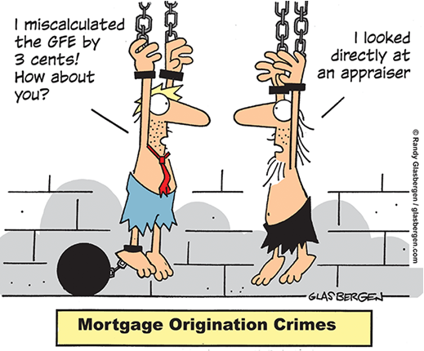

Slide 17
Appraisal Independence Interim Final Rule - Effective 4/1/2011
The interim final rule includes several provisions that protect the integrity of the appraisal process when a consumer's home is securing the loan. The interim final rule:
Prohibits coercion and other similar actions designed to cause appraisers to base the appraised value of properties on factors other than their independent judgment;
Prohibits appraisers and appraisal management companies hired by lenders from having financial or other interests in the properties or the credit transactions;
Prohibits creditors from extending credit based on appraisals if they know beforehand of violations involving appraiser coercion or conflicts of interest, unless the creditors determine that the values of the properties are not materially misstated;
Requires that creditors or settlement service providers that have information about appraiser misconduct file reports with the appropriate state licensing authorities; and
Requires the payment of reasonable and customary compensation to appraisers who are not employees of the creditors or of the appraisal management companies hired by the creditors.

Slide 18
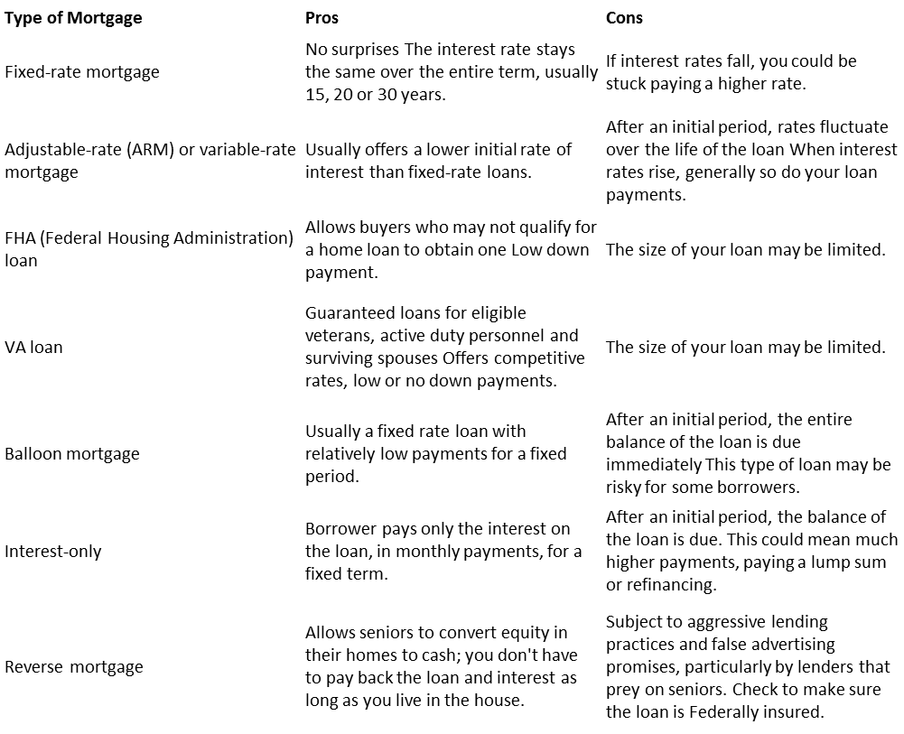
Types of Mortgages

Slide 19
Mortgage Insurance
(PMI, MIP, UFMIP, Funding Fee)
If your down payment on a home is less than 20 percent of the appraised value or sale price, you must obtain mortgage insurance.
Mortgage insurance sometimes is referred to as private mortgage insurance, or PMI, to distinguish it from FHA and VA insurance, run by government programs. The cost of mortgage insurance varies depending on the size of the down payment and the loan, but it typically amounts to about one-half of 1 percent of the loan.
With mortgage insurance, the borrower pays the premiums, but the lender is the beneficiary. The coverage protects lenders against default by the borrower. If a borrower stops paying on a mortgage, the insurance company ensures that the lender will be paid in full.
Mortgage companies pick insurance providers for their customers, but the borrowers have to foot the bill. Usually, they do so in monthly installments. But some lenders offer programs whereby the borrower pays the entire insurance premium in a lump sum at closing.
All FHA loans have a financed Up Front MIP that is 1.75% of the base loan in addition to monthly MIP.
VA loans have a financed Funding Fee that is between 2.15% to 3.3% of the base loan amount but do not have monthly MIP.

Slide 20
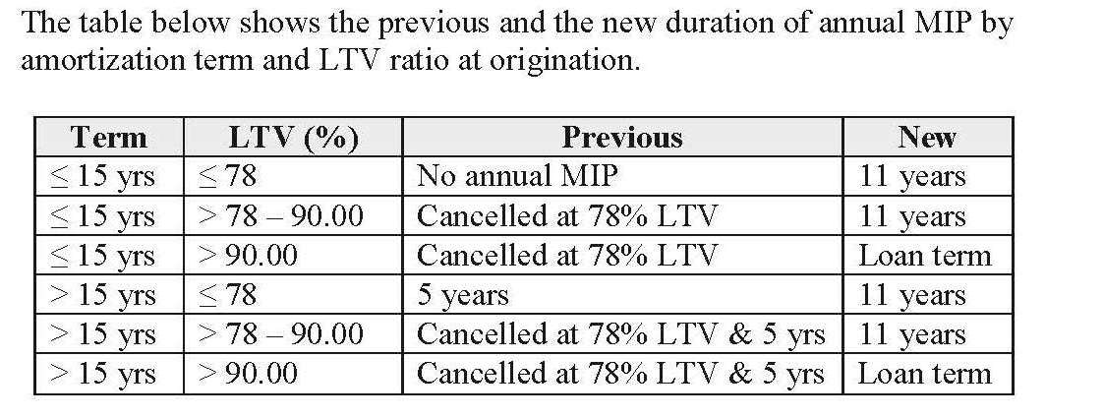
FHA MIP
Effective 6/3/2013

Slide 21
PMI Scenario Assumptions
Base Loan Amount: $405,000.00 Loan Purpose: Purchase
Amortization Term: 360 Months Amortization Type: Fixed
LTV: 90.00% CLTV: 90.00%
Property Information:
Property ZIP Code: 46032 Property Type: Single Family Detached
Property State: Indiana
Occupancy: Primary
Proposed Monthly Housing Expense:
First Mortgage P&I: $2,052.08
Occupying Borrowers Ratios based on qualifying rate of 4.500%
Housing Ratio: 18%
Debt Ratio: 21%
Real Estate Taxes: $375.00
Hazard Insurance: $100.00
Mortgage Insurance: $131.63
Borrower Information:
Occupy Subject Property: Yes
Self-Employed: No
Monthly Income: $15,000.00
All Other Monthly Payments: $500.00
Credit Score: 780
Mortgage Insurance Information:
MI Coverage: 25%

Slide 22
Insured Conventional PMI Options
Monthly Payment Comparison | Borrower-Paid Monthly | Borrower-Paid Single - No Refund | Lender-Paid Single | Borrower-Paid Split Premium Monthly | FHA
Qualifying DTI% Occupying Borrowers: | 21 | 20 | 20 | 20 | 23
Qualifying DTI% All Borrowers: | 21 | 20 | 20 | 20 | 23
Up-front MI Premium: | n/a | $5,143.50 | $5,143.50 | $4,050.00 | $7,087.50
Up-front MI Premium Rate %: | n/a | 1.27 | 1.27 | 1.00 | 1.75
Original (Base) Loan Amount: | $405,000.00 | $405,000.00 | $405,000.00 | $405,000.00 | $405,000.00
MI Premium Amount Financed: | n/a | $0.00 | n/a | $0.00 | $7,087.50
Total Loan Amount: | $405,000.00 | $405,000.00 | $405,000.00 | $405,000.00 | $412,087.50
Initial Note Rate %: | 4.500 | 4.500 | 4.500 | 4.500 | 4.500
Monthly Payment (P&I): | $2,052.08 | $2,052.08 | $2,052.08 | $2,052.08 | $2,087.99
Monthly MI Premium: | $131.63 | n/a | n/a | $27.00 | $438.75
Monthly MI Premium Rate %: | 0.39 | n/a | n/a | 0.08 | 1.30
Other Monthly Housing Expense: | $475.00 | $475.00 | $475.00 | $475.00 | $475.00
Total PITI (including MI): | $2,658.71 | $2,527.08 | $2,527.08 | $2,554.08 | $3,001.74
Housing Cost Over Five Years: | $159,522.60 | $156,768.30 | $151,624.80 | $157,294.80 | $180,104.40
Five-Year Savings Compared to FHA: | $20,581.80 | $23,336.10 | $28,479.60 | $22,809.60

Slide 23


Slide 24
Loan Types: Old Favorites
Conventional
  $417K maximum loan limit
  No PMI at 80% or less LTV
  Up to 97% LTV with PMI
  Max debt ratio of 45%
  Generally requires reserves after close
  FannieMae and FreddieMac

Slide 25
Loan Types: Old Favorites
FHA
  $271,050 maximum loan limit
  UFMIP and monthly MIP generally for life of loan
  Up to 96.5% LTV
  Max debt ratio of 49.9%
  No reserves
  Down payment can be gift
  Lower credit standards

Slide 26
Loan Types: Old Favorites
VA
  Must be veteran with eligibility
  $417K max loan limit
  100% LTV - No down payment required
  No monthly MIP
  Financed funding fee unless disabled
  Max debt ratio of 45%

Slide 27
Loan Types: Old Favorites
Non-Agency (Jumbo)
  Loan amounts from $417K up to $2M
  80% max LTV
  Interest rates higher than conventional
  Considered higher risk
  Max debt ratio of 43%
  Generally require two appraisals
  Limited number of lenders offering jumbo loans
  Guidelines vary by lender

Slide 28
Old Programs in a New Market
Adjustable Rate Mortgage (ARM)
  Rate fixed for initial period (generally 3, 5 or 7 years)
  Variable for life of loan subject to rate change caps
  Good option for borrower who knows they are going to be in home for limited amount of time
Interest Only (not currently offered by SMC)
  Interest only for first 10 years
  Amortizes to 20 year P&I
  Higher rate than fixed but improved cash flow
Line of Credit (HELOC)
  First or second lien
  Variable rate based on prime plus margin
  Line can be paid down and re-used
  Generally have 10 year draw and then 10 year repayment period
  Interest is paid on mortgage loan so may be tax deductible

Slide 30
Q & A and Thank You!
Q & A
Thank you for attending….
If / When you have questions –
Kurt Fancher
Stonegate Mortgage Corporation
9190 Priority Way W. Dr., Ste. 120
Indianapolis, IN 46240
NMLS #354570
317‐663‐5171 ‐ Office
317‐536‐3473 ‐ Secure FAX
317‐697‐8832 ‐ Cell
Please reply to: fancherteam@stonegatemtg.com
www.Stonegatemtg.com/kfancher

Slide 31


