Slide 1
FPA Advocacy: Greater Indiana Update

Slide 3
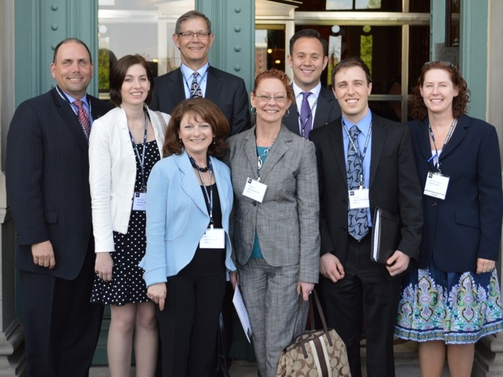
Springfield, Illinois

Slide 4
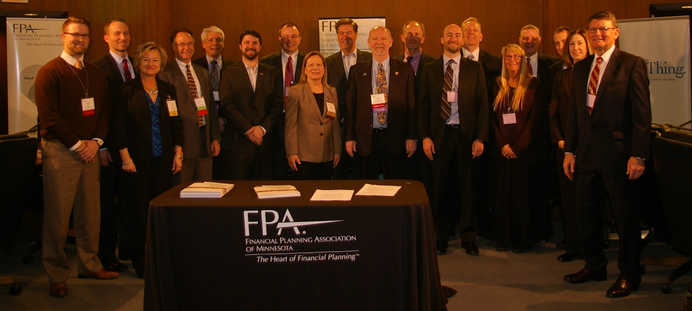
St. Paul, Minnesota

Slide 5
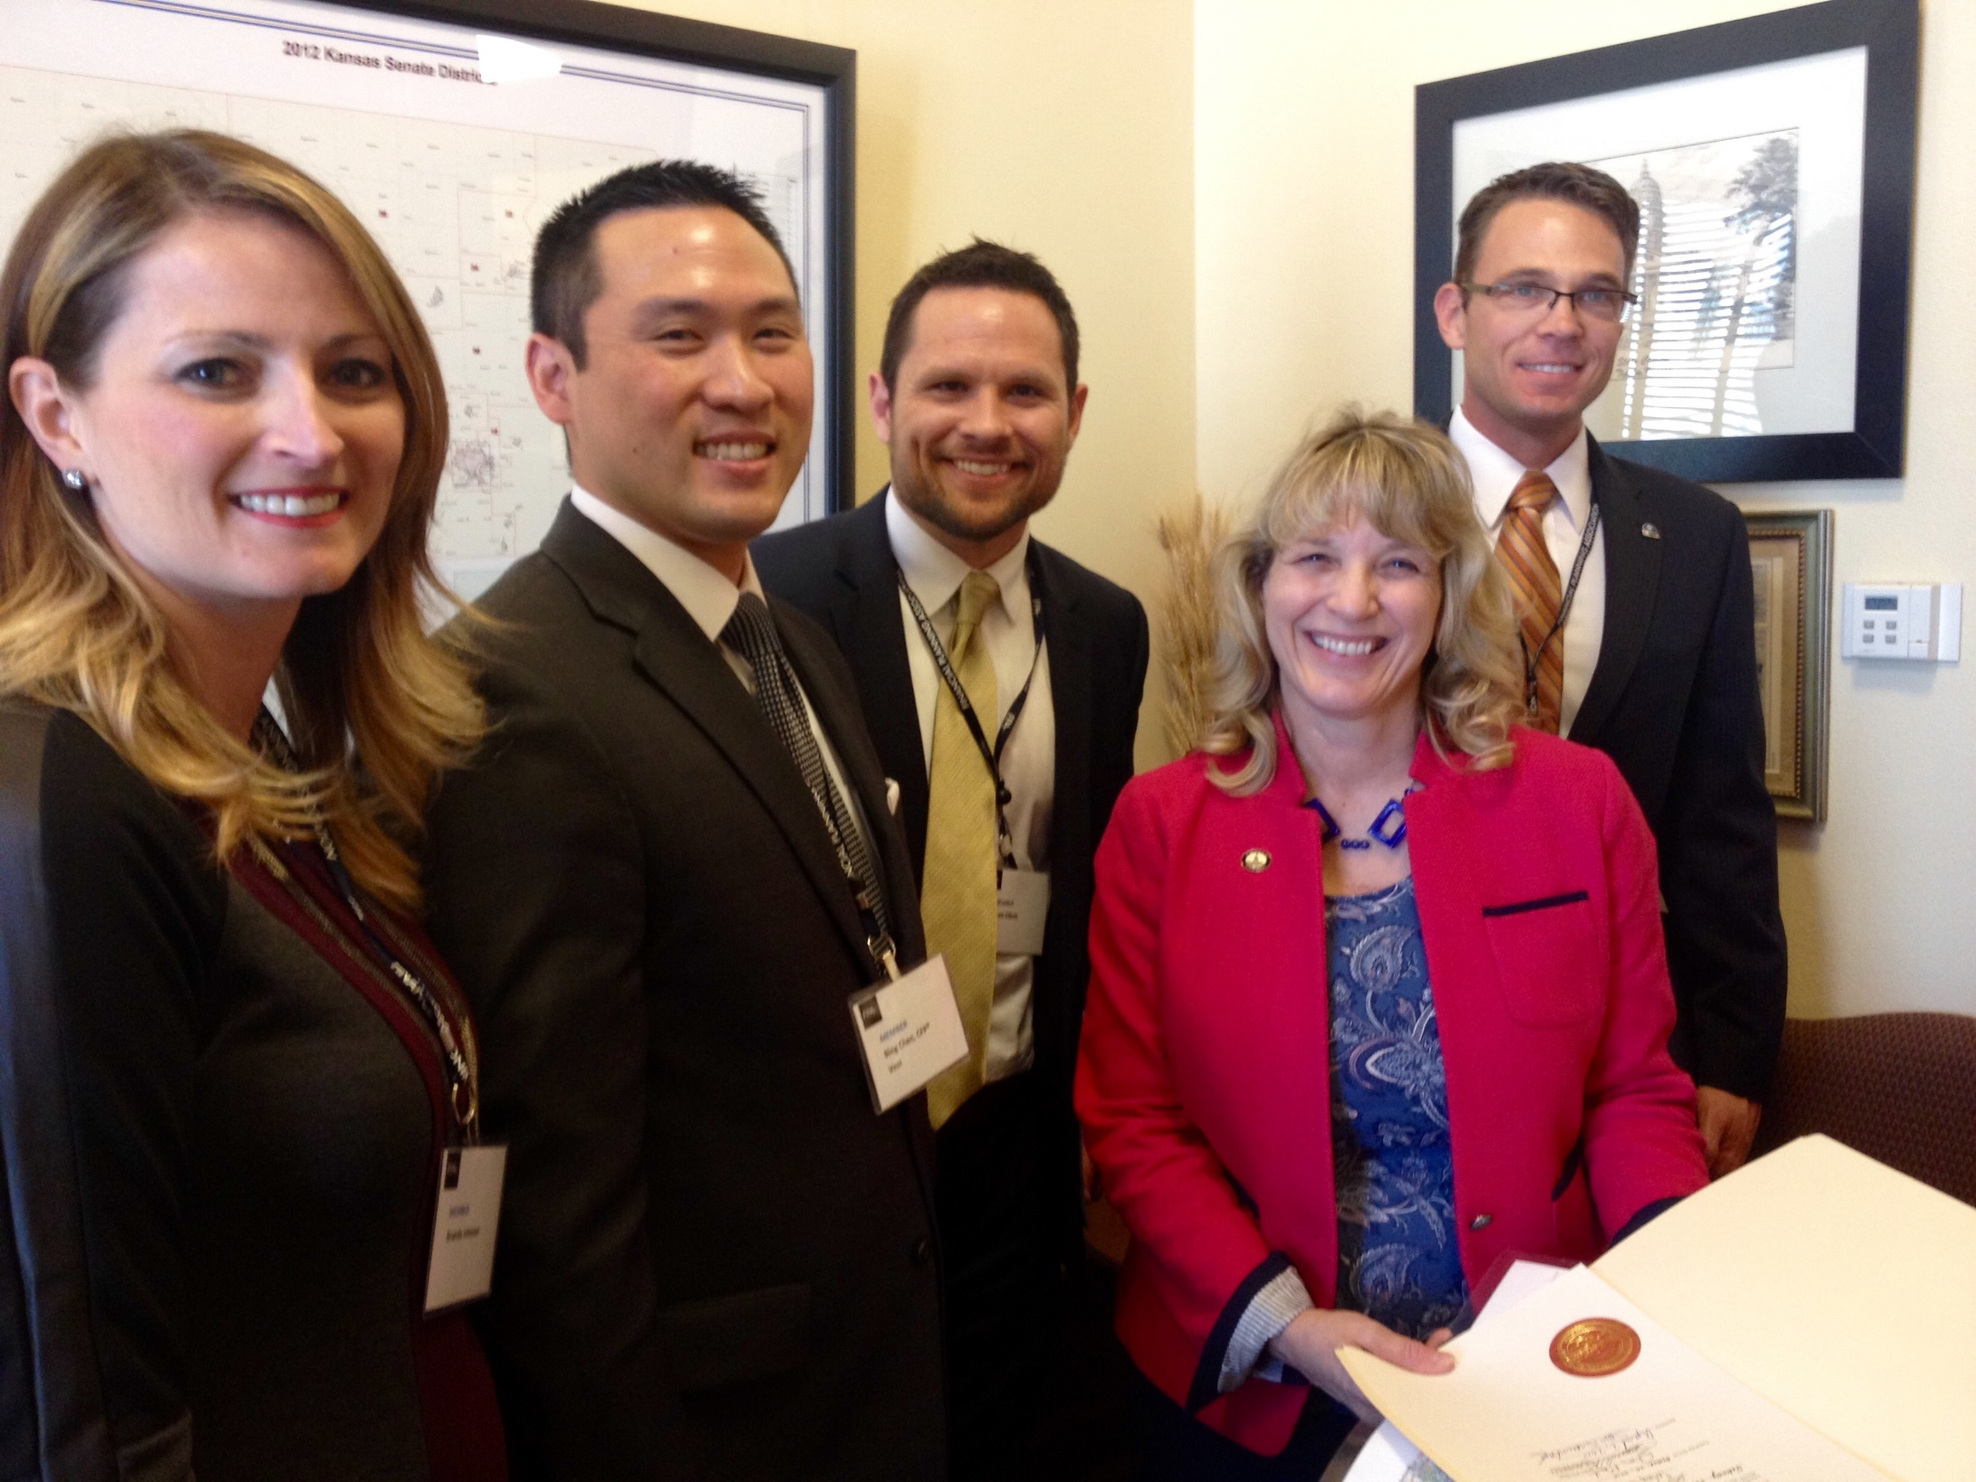
Topeka, Kansas

Slide 6
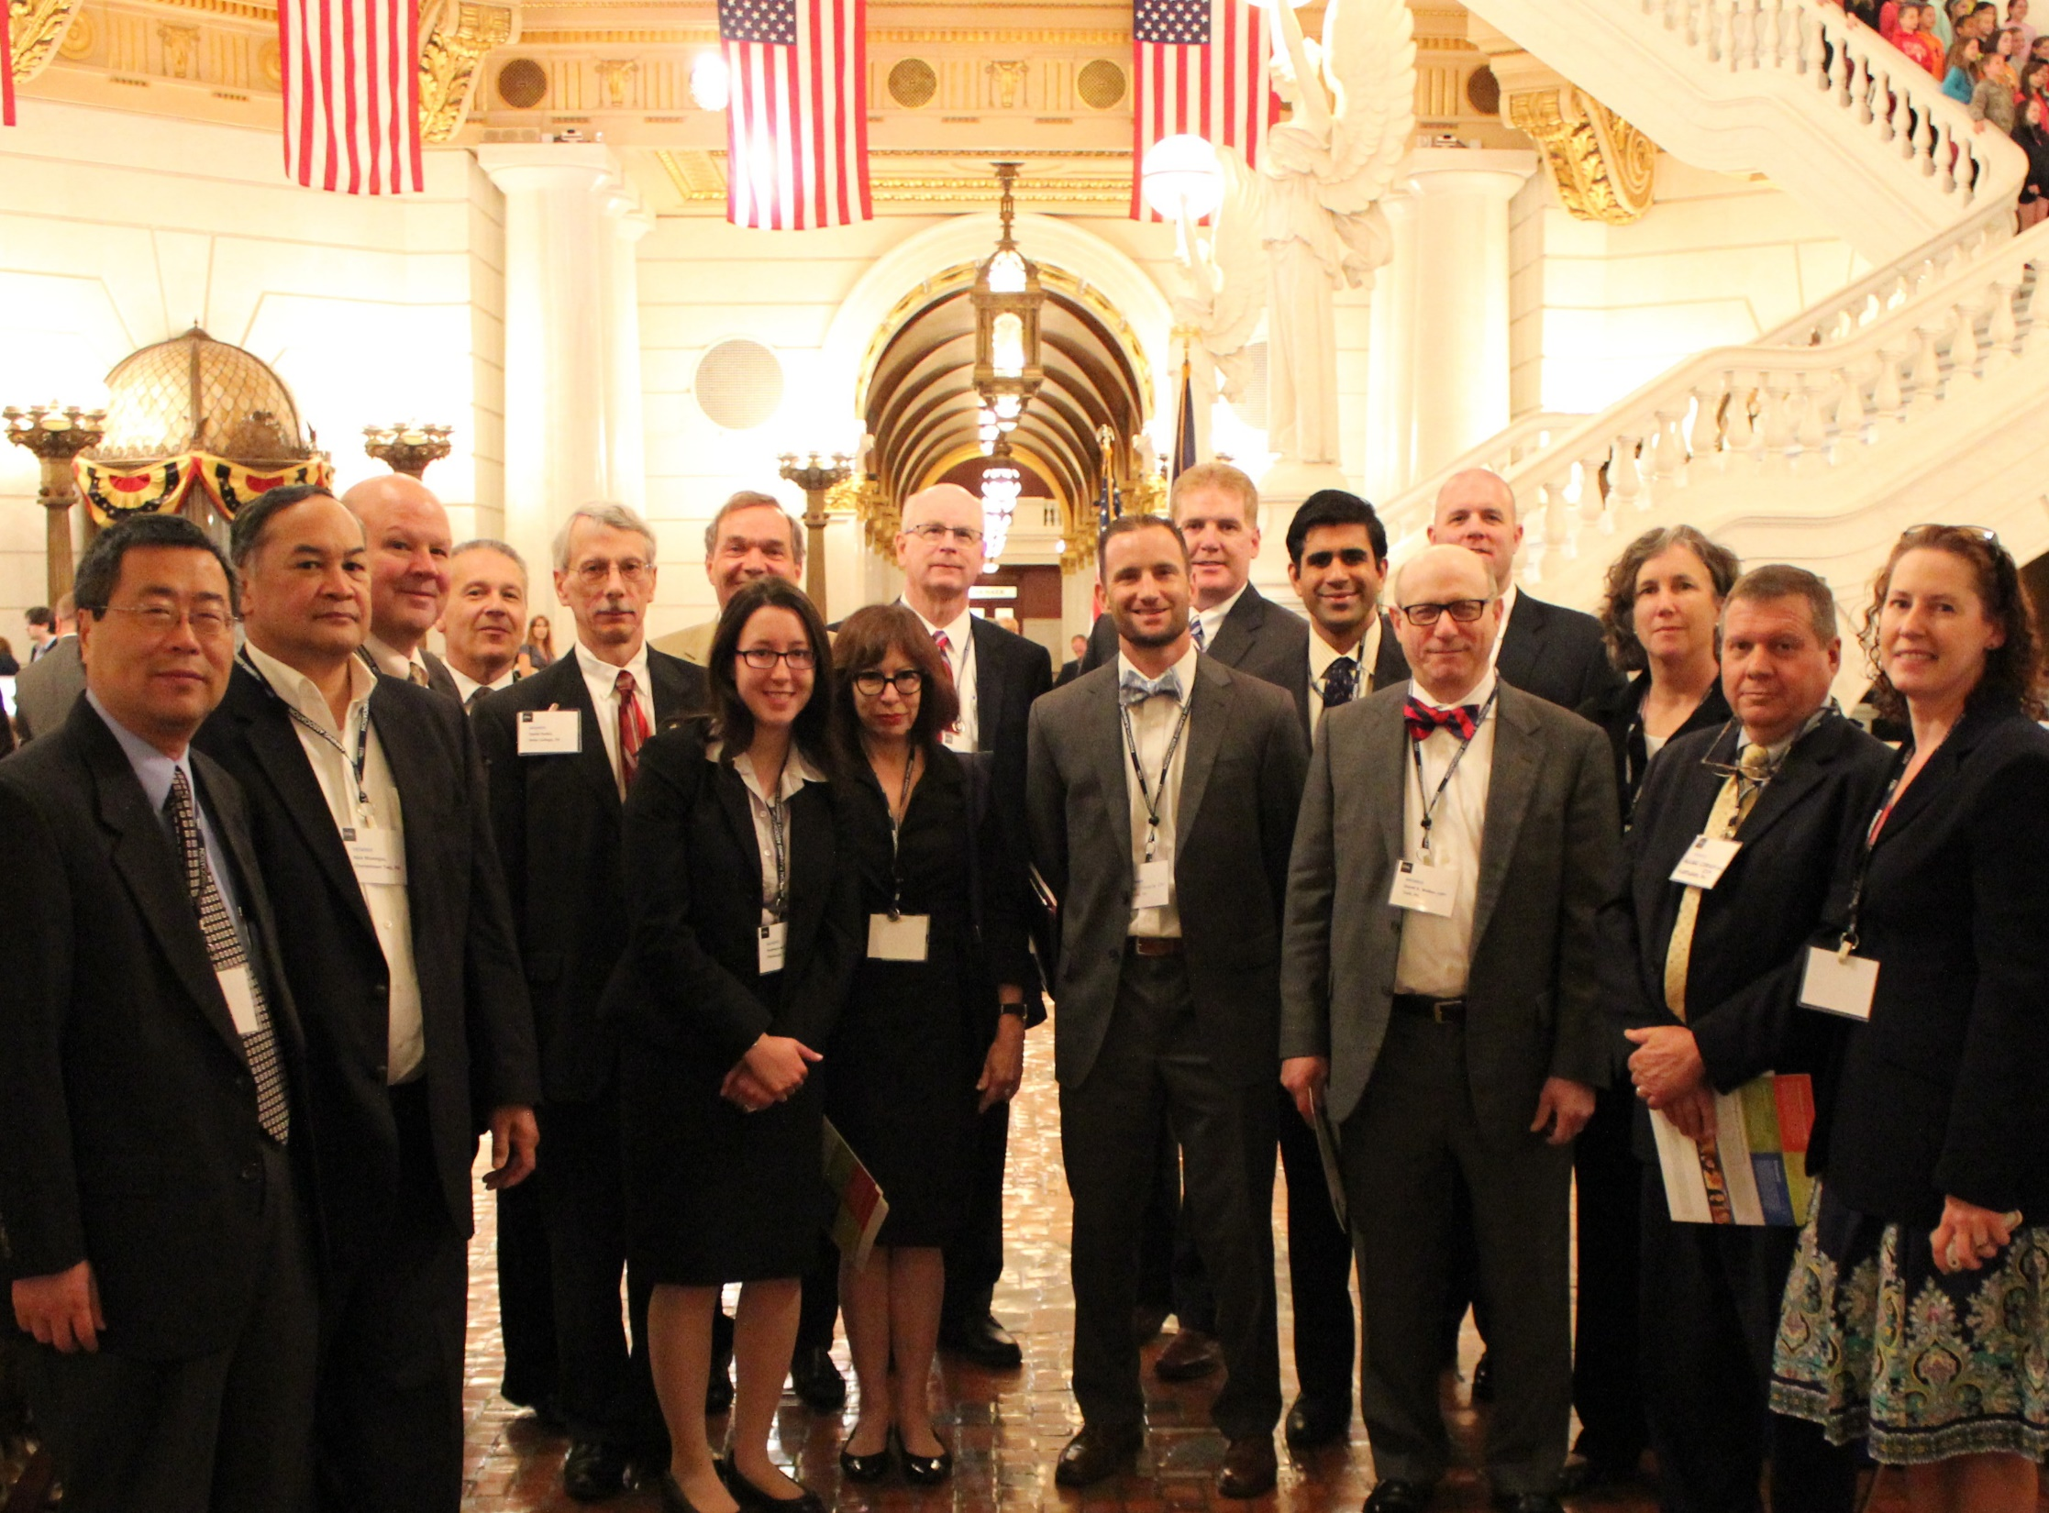
Harrisburg, Pennsylvania

Slide 7
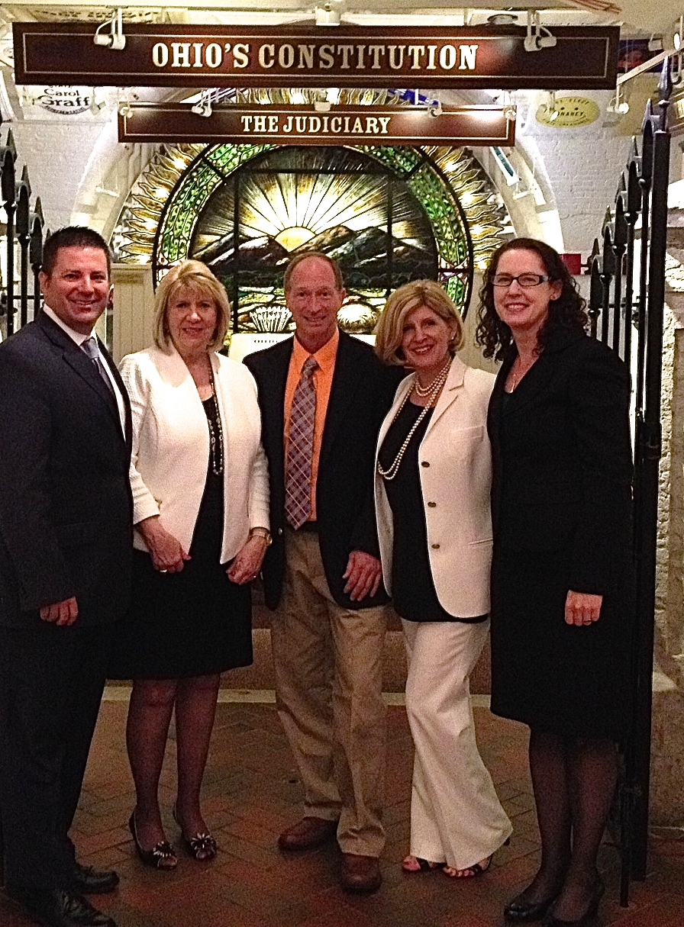
Columbus, Ohio

Slide 8
Indianapolis, Indiana?
Springfield, Illinois

Slide 9
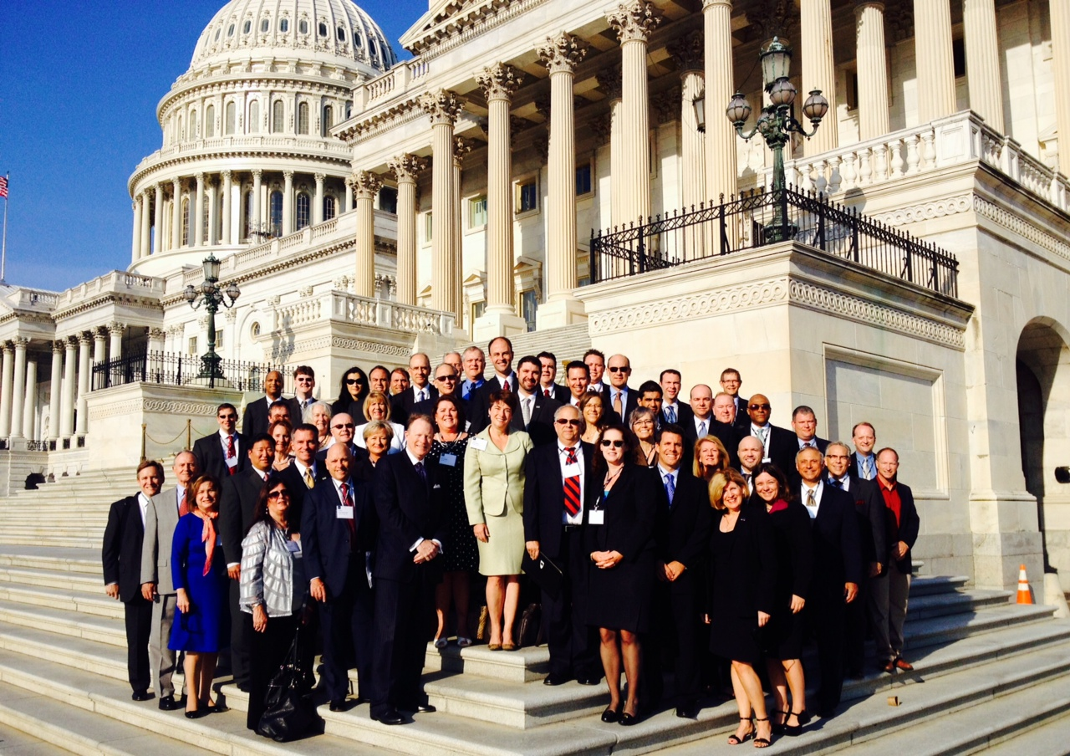
Washington, D.C.!

Slide 10
FPA Policy Update:
FPA Policy Lens
Financial Planning Coalition
SEC Fiduciary
DOL Fiduciary
Financial Planning Services Tax

Slide 11
FPA Bylaws
“FPA will proactively advocate the legislative, regulatory and other interests of financial planning and of CFP licensees. FPA will encourage input from all of its members in developing its advocacy agenda. It is the intent of FPA not to take a legislative or regulatory advocacy position that is in conflict with the interests of CFP® Professionals who hold themselves out to the public as financial planners.”

Slide 12
Rulemaking Landscape:
SEC Fiduciary
SEC Fiduciary Rulemaking. Where is it?
No one can find it.
Authorized 5 years ago… and still waiting
FPA Supports Fiduciary Rulemaking at the SEC
Extend fiduciary standard to broker-dealers when providing personalized investment advice
No less stringent than the 40’s Act

Slide 13
Rulemaking Landscape:
DOL Fiduciary
Rule has been in existence since 1974
Proposed DOL Fiduciary Rulemaking in 2010
Quickly withdrawn
Five years go by… (tic, tic, tic)
February 23rd, 2015 Fiduciary Re-Proposed Rule
75-Day Comment Period Ends July 21 (Coalition Submits 35 pg Letter)
DOL Hearings, August 10-14 (Coalition Testifies First)
Additional Comment Period for 2 Weeks After Transcript Published
Rule Published to Federal Register in Early 2016?
Final Rule Effective in Jan. 2017? (End of Administration)

Slide 14
FPA Policy Position:
Oppose Tax on Financial Plans
Would likely reduce the availability of financial planning services
Are regressive and would reduce access to financial planning services
Are hard to administer and require work to collect and remit
Would place a administrative burden on many members who own
small businesses
Could require additional burdens of registration within a state,
even for a federally registered investment adviser, which would
increase compliance complexity and the bureaucratic costs of the
imposing states
Could drive consumers to seek financial planning services from a state
that does not impose a tax on services

Slide 15
Thank you!
Questions?
Karen Nystrom
FPA Director of Advocacy
knystrom@onefpa.org

