Slide 1
Critical Tax Decisions: That Will Impact Your Retirement
Joseph A Clark, CFP

Slide 2
The Financial Enhancement Group, LLC
The Financial Enhancement Group is an SEC Registered Investment Advisor. Securities offered through World Equity Group, Inc. Member FINRA/SIPC. Advisory services can be provided by Financial Enhancement Group (FEG) or World Equity Group. FEG and World Equity Group are separately owned and operated.

Slide 3
My dear friend Larry

Slide 4
My dear friend Larry
Needs $8,500 a month net to maintain his standard of living.
They accumulated $1,800,000 invested in two accounts. $1,000,000 after tax from the sale of his business and $800,000 in an IRA.
FEG created a plan. By taking distributions from both accounts – taxable and tax deferred – the plan could work.

Slide 5
My dear friend Larry
What do you think Larry said:
“No Way! … Joe, I hate taxes!”

Slide 6
My dear friend Larry
Today Larry has a little more than $1,800,000 but it is all in his IRA. The other after tax account exhausted.
He now has to take $13,000 to net $8,500
Larry had to reduce his income and his standard of living - not over investment results but because of tax decisions!

Slide 7
The Right People, The Right Plan and Follow Through!
Q $×$ A = E
The quality of an idea multiplied by the adoption of the recipient will ultimately determine the excellence or value of the idea!

Slide 8
The Fiduciary Focus
Risk and Volatility
Fees and Expenses
Taxes Today and Tomorrow
Real Return
Stocks, Bonds, Cash
Product Wrapper (mutual fund, exchange traded fund)
Tax Wrapper
401k, 403b, IRA – Roth Option

Slide 9
How should we look at our statements?
What is your financial vision?
You are unique! Your journey is unique.
What Phase of Finance are you in?

Slide 10
3 Phases of Finance
Preservation
Accumulation
Distribution

Slide 11
The Three Phases of Finance
Accumulation: Saving the right percentage of your income and developing accounts with tax diversification (tax deferred, tax free, taxable).
Preservation: You are still saving money, but protecting what you have already established is the most important. This is the only phase where average return matters.
Distribution: Managing the volatility of the accounts where the distribution is coming from and the average tax paid on each dollar you use to maintain your standard of living.

Slide 12
Understanding and controlling your tax return!
39.6%
28, 33, 35%
25%
15%
Think Stair Steps
10%
Considered a progressive system – the more you
make the more you pay and at higher percentages!

Slide 13
Things Change – a lot!
Thought that was a high number!
39.6%
28, 33, 35%
25%
15%
When Reagan took office in 1980 the highest step was
70%
10%
Considered a progressive system – the more you
make the more you pay and at higher percentages!

Slide 14
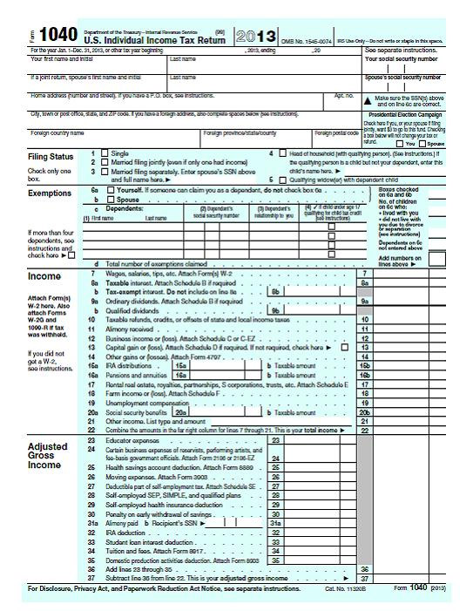
Reading your return
Line 7 tells us if you are eligible to contribute to a retirement plan.
The bottom of page one is your AGI or Adjusted Gross Income.

Slide 15
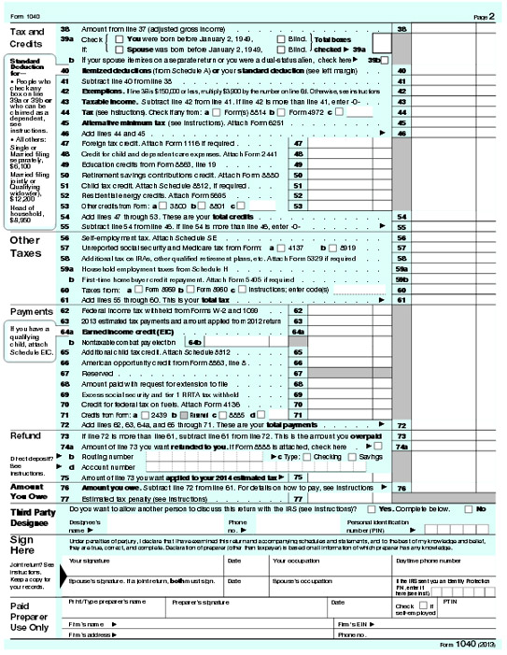
Reading your return
Line 43 tells you what step you will be on!
39.6%
28, 33, 35%
25%
15%
10%

Slide 16
Understanding and controlling your tax return!
Many tax breaks stop above the second step!
39.6%
28, 33, 35%
$153,100 / $91,900
25%
$75,900 / $37,950
15%
$18,650 / $9,325
10%

Slide 17
Retirement Made Simple!
39.6%
28, 33, 35%
25%
Above the line use tax free money when you can
1. Mailbox Checks
15%
2. Income required to meet standard of living
10%
Use tax deferred money in on the lower brackets or steps

Slide 18
The 70 - 70 - 70 Reality
70% of IRA’s and 401k plans are not accessed before required minimum distributions at 70.5.
70% of the tax deferred money goes in tax deferred while you are married filing jointly.
70% of the money comes out when one of the spouses has passed away now filing as an individual.

Slide 19
Widow / Widower Penalty
39.6%
Filing as an individual compresses the marginal tax brackets!
28, 33, 35%
$153,100 / $91,900
25%
$75,900 / $37,950
15%
$18,650 / $9,325
10%

Slide 20
The Purpose for the documents
Most of us don’t die immediately….we fade away.
Someone – our spouse, child, charity – will get the rest.
Hopefully it won’t be the IRS!

Slide 21
Missed Conversations
Roth Conversions and Roth Contributions.
There are very different rules.
They have overlooked benefits for the Legacy Plan.

Slide 22
Roth Contributions and Conversions
There are two C’s with very different rules
Have nothing to do with retirement plans at work
There are AGI restrictions and there are loopholes!
Estate planning opportunities all beneficiaries are not equal

Slide 23
Questions!
Be sure to tune into Consider This… weekly radio show.

