Slide 1
Presentation at 9/20/19 Greater Indiana FPA meeting
by Greg Geisler, PhD
Clinical Professor of Accounting at
Indiana University-Bloomington
Research: Intersection of taxes and financial planning
Teaching: “Income Tax” to future CPAs;
“Taxes & Financial Planning for Individuals” to future CFPs
geisler@iu.edu 812-855-3834

Slide 2
Topic 1 of 2: Tax and Financial Planning Around the Social Security Tax Torpedo
Fact: 10 Million tax returns show > 0% but < 85% of Social Security Benefits Benefits (SSBs) Taxed (included in Income)
Such taxpayers are inside the SS Tax Torpedo
IMPACT: Since more SSBs are taxed as Other Income increases (e.g., withdrawal from tax-deferred retirement account)…
Social Security Benefits Taxation: In 2019 and future, 49.95% is the top effective federal Marginal Tax Rate if income includes Qualified Dividends (Qual. Divs.) or Long-term Capital Gains (LTCGs)
If only ordinary income (i.e., no Qual. Divs. or LTCGs),
40.7% is the top effective federal Marginal Tax Rate

Slide 3
Sources for Topic 1 of 2: JFSP ‘17 article
ttps://www.dropbox.com/s/l0mcz3x9acq825i/Screenshot%202019-06-07%2014.35.15.png?dl=0

Slide 4
Sources for Topic 1 of 2: JFP ‘16 article
ttps://www.dropbox.com/s/l0mcz3x9acq825i/Screenshot%202019-06-07%2014.35.15.png?dl=0

Slide 5
What You Will Learn About the Social Security Tax Torpedo
How to identify when a client/taxpayer is in the SSBs tax torpedo range using their Form 1040.
2) For such a client/taxpayer’s, what their effective marginal federal income tax rate is.
3) For a client expected to be in the worst part of the tax torpedo range when retired, their tax rate is lower now and, thus, should contribute to Roths!
4) For such a client, where to withdraw funds from.

Slide 6
Summary of SS Tax Torpedo
Maximum of 85% of Social Security benefits could be taxable, with the percentage increasing as income increases.
Additional income can cause additional Social Security benefits to be taxable, a so-called tax torpedo.
The tax effect of this tax torpedo depends on the tax rate bracket in which the SSBs are taxed.
The worst part of the SS Tax Torpedo range is when taxpayer’s Taxable Income moves them into the 22% statutory tax rate bracket because the effective marginal tax rate is 40.7% of the additional income, or 49.9% of the additional income if the taxpayer has significant Qualified Dividends or Long-Term Capital Gain income

Slide 7
How to Tell if Client is Inside SS Tax Torpedo Range
Greater than 0% and Less than 85% of Social Security benefits are taxable (i.e., included in Form 1040’s income)
Form 1040 (page 2): Line 5
5a) Social security benefits (total)
5b) Taxable amount (of SSBs)
If 5b) = $0 then taxpayer is below phase-in of SSBs
If 5b) / 5a) = 85% then taxpayer is above phase-in of SSBs

Slide 8
2019 Individual Federal Tax Rates
SINGLE
If taxable income > | But not over: | The tax is:
$0 | $9,700 | 10% of taxable income
$9,700 | $39,475 | $970 plus 12% of the amount over $9,700
$39,475 | $84,200 | $4,543 plus 22% of the amount over $39,475

Slide 9
Graph of SS Tax Torpedo on Single Taxpayer’s Effective Marginal Federal Tax Rate
This depicts additional tax rate from additional ordinary income for a Single individual with $30,000 of Social Security benefits, taking into account the tax on any additional SSBs Note: All income’s ordinary

Slide 10
Comparing Tax Rate Brackets to Effective Federal Marginal Tax Rates
When social security benefits (SSBs) are received,
the usual federal tax rates of 0%, 10%, 12%, 22%, etc., change to effective marginal tax rates (MTRs)
of 0%, 15%, 18%, 22.2%, 40.7%, 22%, etc., due to SSBs phasing in as taxable (i.e., included in Income) until reaching the maximum taxable % of 85%.
Further, if the taxpayer’s income includes qualified dividends or long-term capital gains, an effective MTR of 49.9% is sandwiched between the 22.2% & 40.7% MTRs.

Slide 11
Single taxpayer in 2019 at top of 12% tax rate bracket BEFORE $1,000 more income (Note: $0 Long-Term Capital Gain (LTCG) & Qualified Dividend (QD) income)
 | Pre Add’l Income | Additional Income
Additional ordinary income | n/a | $1,000
Income | $51,675 | $53,525ª
Standard Deduction | −$12,200 | −$12,200
Taxable Income (TI) | $39,475 | $41,325
Taxed at 10% | $9,700 × 10% = $ 970 | $9,700 × 10% = $ 970
Taxed at 12% | $29,775 × 15% = $3,573 | $29,775 × 15% = $ 3,573
Taxed at 22% | $0 | $1,850 × 22% = $ 407
Total Tax^{b} | $4,543 | $ 4,950
Increase in Tax | $407 (i.e., $1,850 × 22%))
Effective Federal Marginal Tax Rate 40.7% a - Income is $1,850 higher—$1,000 from add’l income & $850 more SSB income

Slide 12
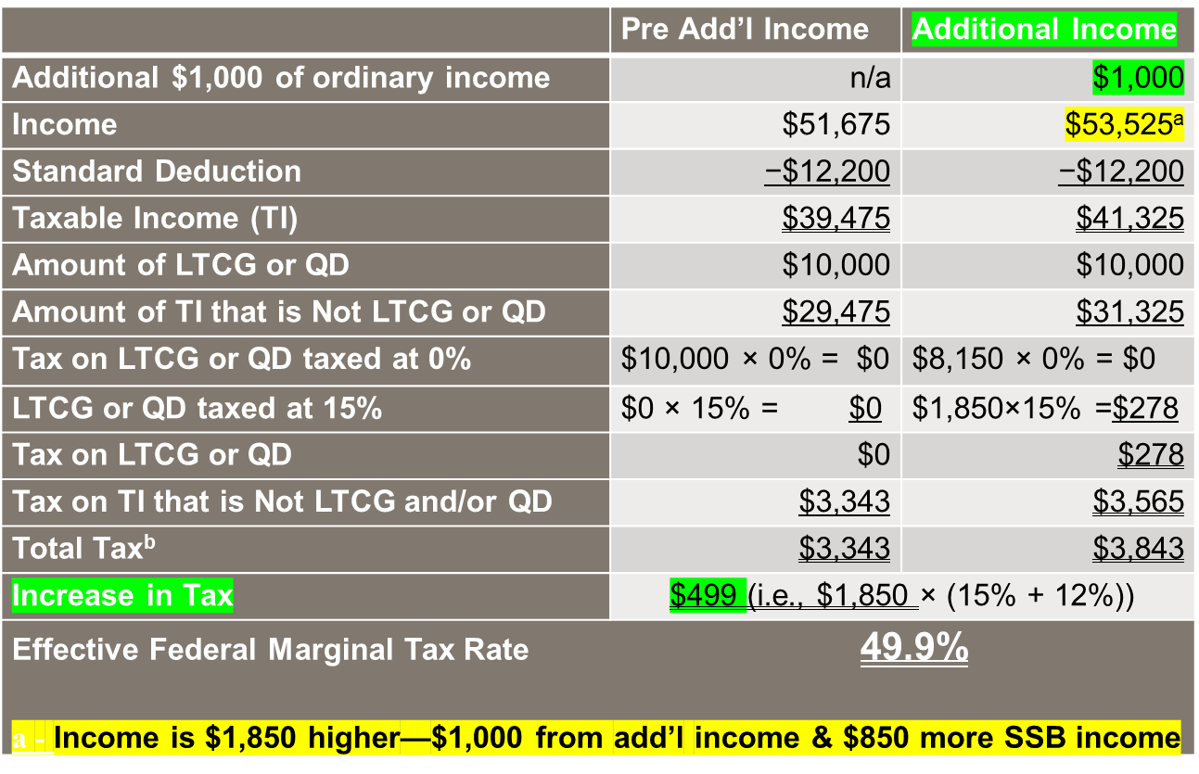
Single taxpayer in 2019 at top of 12% STR bracket with $1,000 more income (& ≥ $1,850 LTCG or QD)

Slide 13
Graph and Two Tables Show that the Worst Part of the SS Tax Torpedo is?
Answer: When Taxable Income goes into the beginning of the 22% bracket! This happens
For Single when TI > $39,475 in 2019
(i.e., when Income > $53,325 if Single)
For Married when TI > $78,950 in 2019
(i.e., when Income > $105,950 if Married)
Assumptions: Taxpayer(s) ≥ age 65 and Don’t Itemize

Slide 14
i) Implications of the SS Tax Torpedo
Typical assumption is that most clients will have lower Taxable Income when Retired since no more salary
Taxable Income is NOT relevant!
Marginal Tax Rate is relevant!!
If client will be in SS Tax Torpedo range when retired it is likely their Marginal Tax Rate will be higher than now!
Recommendation for such clients:
“Contribute to Roths instead of Tax-deferred retirement accounts now (while still working)”

Slide 15
ii) Implications of the SS Tax Torpedo
If client will be in SS Tax Torpedo range when retired,
DELAY Social Security!
The longer Social Security delayed toward age 70 the more years that the SS Tax Torpedo is avoided.

Slide 16
Tax Planning & the SS Tax Torpedo
What did the two tables teach us about client in or near the worst part of the SS Tax Torpedo?
If client needs more cash for current year spending,
DON’T take it from Tax-Deferred Retirement accounts (like 401(k)s and IRAs).
Instead, take it from location where as little income is triggered as possible (in order starting from best location):
Roths
Interest-bearing taxable account (since income not triggered and typically very little capital gain triggered)
Stocks (the less appreciation the better as cash source)

Slide 17
Income Planning & the SS Tax Torpedo
High-value service of financial planners is “Tax-Efficient Recommendations” of funding sources for each year’s spending during client’s retirement.
Avoiding as much of the Social Security Tax Torpedo range as possible—particularly the worst part when the Client’s effective marginal federal tax rate is around 40% to 50%—is of great value
Some clients can’t avoid such range, particularly after turning age 70½ and “uncontrollable” income (i.e., RMDs from tax-deferred accounts, Social Security, pensions) places them in the 85% of SS is taxable every year…
BUT, with help, especially pre 70½, torpedo avoidance is possible!

Slide 18
“Break time”
then Presentation 2 of 2:
“Tax-Efficient Withdrawal Strategy During Retirement”

