Slide 1
The Next Wave of Advice Management
Jake Norton
Regional Director – IN, KY, MI, OH
610.676.2099
jxnorton@seic.com

Slide 2
SEI Advisor Network › Practice Management
Best Practices
Best Practices
Best Practices
Sales & Marketing
Client
Service
Business Planning
Operations
Best Practices
Transition
Phase
Advisor Experience
Efficiency
Phase
Industry Experience & Resources
Growth
Phase
Advisor Business
Phases

Slide 3
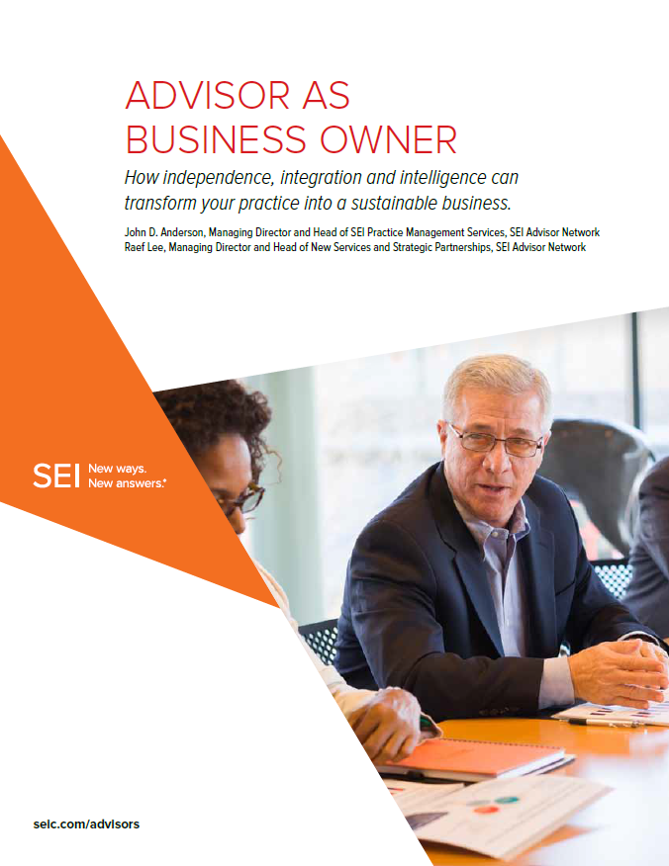
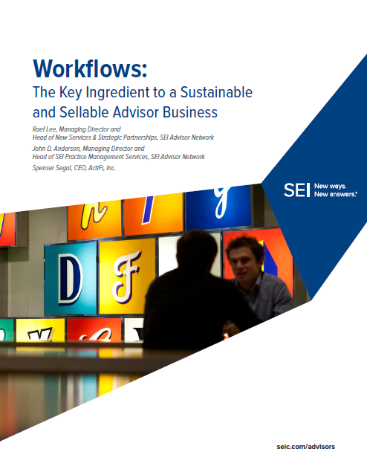
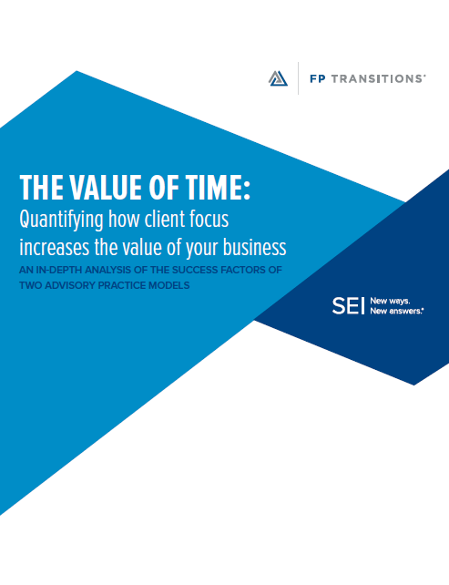
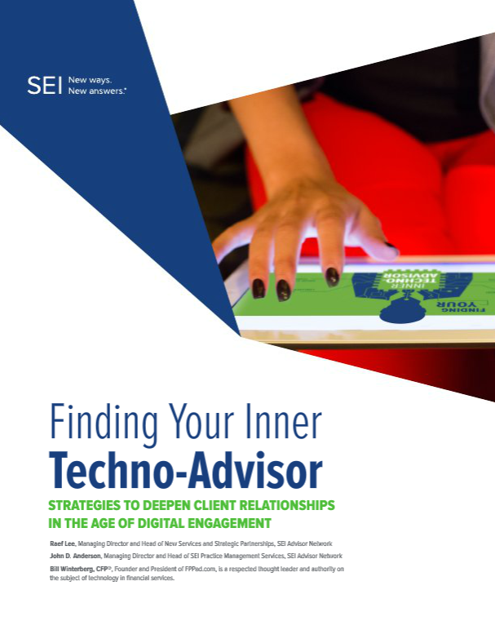
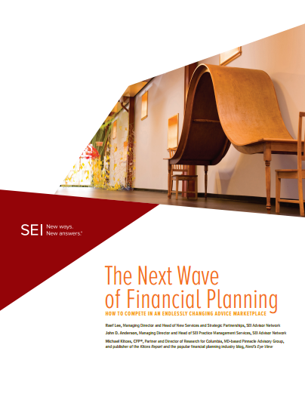

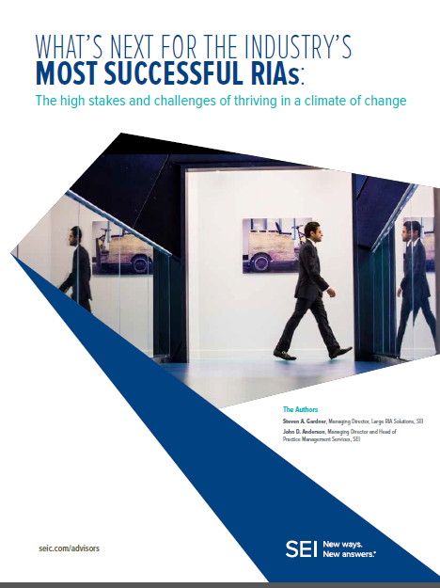
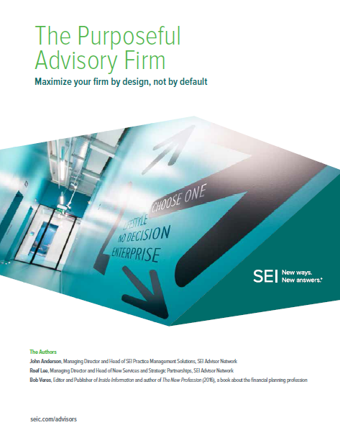

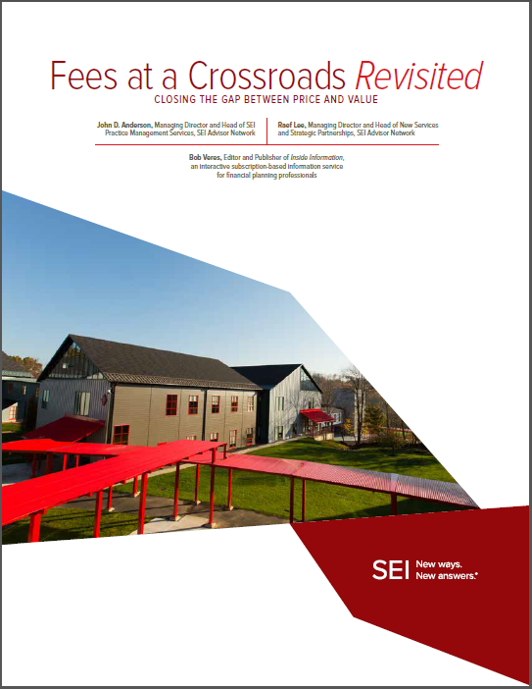
Thought Leadership White Papers ›
How to Work on Your Business

Slide 4
The Future of Advice Management › Summary
John D. Anderson
Managing Director and Head of Practice Management Services
SEI Advisor Network
Raef Lee
Managing Director and Head of New Services
and Strategic Partnerships
SEI Advisor Network
Spenser Segal
CEO and founder of ActiFi and one of the industry’s most respected thought leaders
Industry insights:
Hussain Zaidi, CFP® Co-founder and CEO
of Advizr
  Bob Curtis, Founder and CEO Pietech/MoneyGuidePro®
Primary Research:
Financial Advisor Online Survey* - Focus on financial planning and business processes: 542 respondents, November 2017
  46% RIAs or Hybrid firms
  45% BD-affiliated
  75% in business 10+ years
  49% have between 3 – 10 employees
Process Assessments** - We tracked the performance of 46 firms between September 2015 and December 2017, before and after they implemented repeatable processes to determine how it ultimately impacted their business.
  Average # of clients/firm – 262
  Average # of employees – 3.7
* Conducted by SEI
** Conducted by ActFi as part of SEI’s workflow program

Slide 5
Agenda
The Present, Future, and Evolution of Advice
The Future Is Already Here
    How Techno-Advisors and Clients Collaborate
    A smarter front office, more satisfied clients
    Financial Planning 2.0
The Glue of Advice Management: Your Co-planning Process
Your Roadmap to an Advice Management Business Model
Notes:
Today, we’re going to talk about

Slide 6
The Evolution of Advice

Slide 7
The Evolution of Advice
1980’s
Advisors paid by selling insurance and limited partnerships (product-centric).
1990’s
Computers give access to investment information, boosting mutual fund boom.
Needs-based approach expands with financial planning.
2000’s
The rise of the AUM model.
The financial crisis and its aftermath.
2010’s
CRM becomes the client hub; financial planning becomes the value hub.
Different advice models for unique client segments.
Birth of Techno-advisors.
Tomorrow
24/7 digital access
Investor driven advice
Product-driven sales
Needs-based selling
AUM Model
Financial planning
Notes:
The evolution of advice
Pioneered by insurance agency and wirehouse defectors, early financial planning proved a convenient means to an end. These ambitious small business proprietors focused on product sales, with gross commissions as their true measure of success. It took the financial planning industry a half-century to evolve from the dark ages of high-commission estate planning, insurance and fee-laden, tax-focused limited partnerships to where it is today.

Slide 8
Innovation & Demand › Driving Evolution
Shift from an Advisor-centric model to client-centric model
Industry challenges:
    Fiduciary movement
    Low-priced digital advice disruptors
    Commoditization of investment advice
    Changing investor demographic
Consumers are demanding:
    Participation
    Transparency
    Value

Slide 9
The Client Experience Is Front and Center
No single reason dominates for moving an advisory relationship.
Source: Phoenix Synergistics, Financial Advice and Planning for the Mass Affluent, 2017, page 9
Notes:
Today’s generation of advisors inherit an industry radically transformed by technology, product innovation, and a landscape altered by the global financial crisis. Market research reveals that clients define successful relationships with their advisors as being easy to work with and having a deep understanding of their unique situation. Specifically, clients seek measurable value, e.g., personalized advice and error-free service, from their advisors; they are willing to replace their advisors if they don’t get it.
The message is clear; consumers expect value from their financial advisors. Talking to clients; delving deeper; monitoring their satisfaction and concerns; and delivering real and unique value will be the new standard.
Delivering on that promise of a consistently high-quality client experience is still more aspirational than actual today. No one has automated financial planning processes in a way that can effectively personalize a lifetime of advice for each client. “Financial planning was cumbersome when we entered the market in 2000,” says Bob Curtis, founder and CEO of MoneyGuidePro®. “Early software was based on an accounting orientation with hundreds of columns and complex calculations,” he explains.

Slide 10
The Future of Advice Management Is Already Here

Slide 11
The Future of Advice Management Is Already Here
It’s where high-tech meets high-touch
It’s where opportunity meets value
It’s how advisors deepen client engagement and provide more holistic advice in a scalable way
It resembles the medical, accounting, and legal professions –
    University preparation
    Rigorous professional training
    Designations and standards
Client
Advisor
Customization
Mechanization

Slide 12
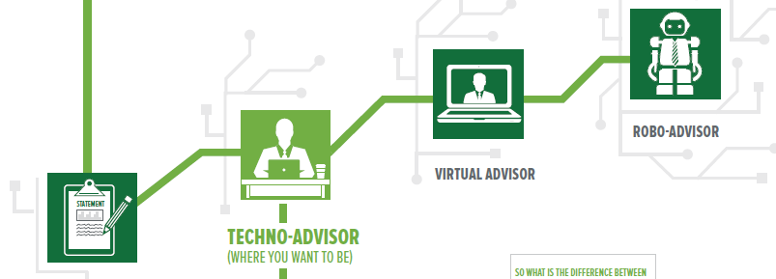
The Future Is Already Here ›
How Techno-Advisors & Clients Can/Will Collaborate
Techno-Advisor
OUTSIDE
Client interaction:
Co-plan
Prospect-to-client engagement
Integration of client management tools (e.g. scheduling software, co-browsing)
“Micro-moments”
INSIDE
Front-office technology & workflow:
CRM: the client hub
Financial planning: the value hub
Risk tools
Document management
Aggregation
Client portal
Customization
Mechanization
Notes:
The Future: How Techno-Advisors and Clients Will Collaborate
Proliferation of fintech solutions has given rise to the techno-advisor – a new breed of professional who uses technology selectively and intelligently to deepen client relationships. The automate-and-personalize approach embodies how clients interact with their advisor, and how advisors guide investors by merging technology with a hands-on approach. It’s the way advice-focused advisors are truly differentiating themselves in the shift from practice to business. “Automation,” says Hussain Zaidi, CFP®, CEO of Advizr, “will continue to evolve – not to the point of replacing advisors, but enabling them to provide more holistic advice in a scalable way.”
Co-planning: A different approach to working with clients and creating value
All good advice needs to be framed in the context of a plan, insists Bob Curtis. “Our research finds that many clients prefer starting the process themselves in the comfort of their own home – it takes some of the fear of planning out of the equation. You’ll discover, because they’ve told you, that they worry about losing money; another great recession; someone getting sick or dying; a good plan addresses these and other emotionally-charged issues.” The key, he explains, is getting the client more actively engaged.
Prospect-to-client engagement
Robo platforms and client portals are shaping the front office and client experience from the moment of engagement. The challenge is to make that process seamless in the prospect-to-client journey. Prospects can start the financial planning process on their own through a guided experience, which helps the advisor from an efficiency standpoint. “Getting the prospect more involved early helps everybody, says Hussain Zaidi, CFP®. “It’s a good use of automation and helps the advisor spend more time on higher value client services.”
Creating value through a series of micromoments
Techno-advisors can differentiate themselves from a mere robo solution through what Google calls “micromoments.” These are defined as critical touch points that, when added together, ultimately shape the customer journey. We view these as opportunities to reach out to clients systematically to demonstrate your value and bind you closer together. However, advisors must be ready to act when that moment arises.
In the fall of 2017, Equifax announced a cyber security incident potentially impacted 143 million U.S. consumers. At conferences a few weeks later, SEI’s John Anderson asked how many advisors in the room had taken advantage of the Equifax hack to engage with clients. Out of 200 advisors only four hands went up – a staggering 196 missed opportunities. Think about that. If the average advisor serves 150 client families, that’s 29,400 families who didn’t hear from their advisor or went somewhere else for information about how the breach may have affected them. How do you ensure that you won’t miss the next micromoment opportunity? See http://seicblogs.com for ways to capitalize on news your clients care about.
Emphasis on Personalized Client Experience: Beyond investment performance, the quality of the investor experience has a significant impact on client retention and revenue generation. The goal for most firms is to deliver an experience where everything works. Those that fail to meet client expectations risk being left behind – if not failure. Bob Curtis asks, “Why would the client pay a premium to get an experience that is anything but highly personalized? The advisor’s value is enhanced through that personal attention.” High-Tech, High-Touch: Traditional wealth management services are becoming increasingly commoditized as new entrants automate planning, advice and cash flow management. In addition to reducing costs, the high-tech, high-touch approach can add capacity, improve productivity, enhance competitive advantage, and meet clients’ needs on their terms. While digital solutions can play a valuable role in automating elements of the investment process, the human touch remains central to the advice management experience.
Mobile Friendly: The digital disruption in financial services mirrors what has transpired in retail and other industries. “These intuitive tools support both clients and advisors and can boost client engagement in a powerful, interactive way,” says Hussain Zaidi, CFP®. And it’s not just younger consumers who want to use digital investment tools on the go and on their mobile devices. Research reveals that older and richer investors are even more concerned about digital access. Investors across generations and wealth levels want the same customer experience from investment providers that they get from Apple and Amazon.

Slide 13
From Traditional Financial Planning to Financial Planning 2.0
Financial planning is changing - used interchangeably with advice.
CFP Board Definition: The process of determining whether and how an individual can meet life goals through the proper management of financial resources – integrating a disciplined process with key subject areas.
 | Financial planning process | Financial planning subject areas
1 | Establishing and defining the client-planner relationship | Financial statement preparation and analysis (including cash flow analysis/planning and budgeting)
2 | Gathering client data including goals | Insurance planning and risk management
3 | Analyzing and evaluating the client’s current financial status | Employee benefits planning
4 | Developing and presenting recommendations and/or alternatives | Investment planning
5 | Implementing the recommendations | Income tax planning
6 | Monitoring the recommendation | Retirement planning Estate planning
Source: CFP Board, https://www.cfp.net/for-cfp-professionals/professional-standards-enforcement/compliance-resources/frequently-asked-questions/financial-planning

Slide 14
The Future Is (Nearly) Here › Financial Planning 2.0
New software and new types of client are changing the way the planning process is used in practice.
Planning process is still relevant but there is an end of the financial plan as a book for the shelf – now a living thing
Technology makes client fact-finding and reporting easier and driven by the client
Allows the plan to be broken into modules and spread over time and repeated – ongoing planning
The investor is a co-creator of the plan
Technology and integration allows the goal of ‘only entering data once’
New generation of financial planning
companies aiding the disruption

Slide 15
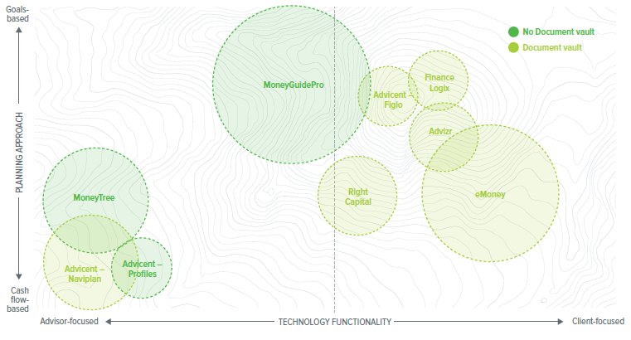
The Future Is Already Here ›
Financial Planning Tools Landscape
Size of bubble correlates to market share
Sources: Size of the bubble – 2017 Software Survey – T3, Advisor Perspectives and Inside Information;Goals vs Cash Flow – Financial Advisor’s Guide To Choosing The Best Financial Planning Software (For You), kitces.com, March 21, 2016; Document vault evaluation – SEI competitive research on company websites.
Notes:
Mapping the financial planning landscape
As we considered the best way to illustrate the landscape, we settled on three data series: market share, technology functionality and planning approach.
Bubble size relates to market share as a factor for comparison purposes. MoneyGuidePro® and eMoney are clearly the dominant players with the longest tenure (15+ years); but new entrants are filling gaps in new ways with attractive features, for clients and investors.
On the X axis, we attempted to plot each vendor’s technology functionality, specifically whether the software company built functionality chiefly for the advisor or the client/investor. For example: eMoney has built numerous features in its client portal that support client engagement and marketing, while other tools are more advisor-focused with key features for advanced planning analysis.
The Y axis represents our assessment of each software vendor’s planning approach. On one end of the spectrum you have tools truly focused on a goals-based planning approach, like MoneyGuidePro®. On the other end, you have more cash flow based planning tools, like eMoney. Then in the middle you have planning tools that offer functionality that support both approaches, like Advizr.

Slide 16


A View from the Top › Two Financial Planning Company CEOs
Bob Curtis, MoneyGuidePro®
“As an industry, we need to give advisors simpler ways to get started – educating clients and creating interest in the core components of a true plan”
Founded: 2000
Founder and CEO
Focus: Comprehensive financial planning solution
# of employees: 200
Market share: 42%*
Hussain Zaidi, CFP® Advizr
“By focusing on the end client’s experience, and providing advisors coaching and education, they can incorporate planning in
a scalable way.”
Founded: 2013
Co-Founder and CEO
Focus: Intuitive financial planning for investment advisors
Number of employees: 30
Market share: 4%*
Sources: Information provided by Bob Curtis and Hussain Zaidi, CFP®
* 2017 Software Survey-T3, Advisor Perspectives and Inside Information
None of the entities listed on this slide are affiliated with SEI.

Slide 17
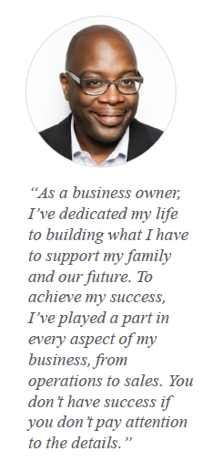

Applied Mechanics › Established High Net Worth Investor
His Goals:
Have enough to support his lifestyle now and in retirement
Make sure he’s prepared for unexpected expenses
Allow ability to pursue second careers and multiple homes
Actively give back to his community
Leave a legacy for his children and grandchildren
Implications for planners/advisors:
A deeper planning process to truly understand his goals.
A solid cash flow is needed: now and in the future
Additional services needed: real estate, estate planning and charitable strategies
Comprehensive planners will want to go beyond just investments
Tax analysis informs the investments and strategies
Best suited software: holistic planning software (e.g., MoneyGuidePro® or eMoney)
Hypothetical example

Slide 18


Applied Mechanics › Emerging Wealthy Investor
Her Goals:
Provide financial security for her family
Build wealth for her retirement
Reduce her overall household debt
Save for her children’s college education
Make sure she’s prepared to take care of her parents
Implications for planners/advisors:
Desire to actively participate in the planning process
Invite Nicole and her husband to engage in co-planning
Focus on goals more, and less on investing
Manage debt, save for retirement and children’s education – a money-in, money-out approach
If new to planning, maybe offer “light” or intuitive planning to expand beyond investment focus
Best suited software: modular planning software (e.g. Advizr, Right Capital, etc.).
Hypothetical example

Slide 19
The Future Is Already Here › Co-planning Approaches
Goals-based financial planning:
Captures dollars that are allocated towards a specific (or multiple) goal(s) and projects whether the goal(s) will be achieved.
Can be modular or holistic.
Fees based on the extent of the analysis.
Cash-flow-based financial planning:
Typically aims to account for every dollar in the household – combining the total inflows from various sources, then ensures that they fully match the total outflows (e.g. spending and expenses).
Traditional comprehensive plans use this approach.
Fees based on the complexity of the analysis.

Slide 20
The Future Is Already Here › Types of Co-planning
Project-based planning:
May be working with a younger investor who isn’t ready to commit or an investor who thinks they want a one-time financial plan.
Client is savvy about technology and investments, but wants validation.
One-time fee with the potential of converting to a retainer or AUM based model.
Modular planning:
Great way to initiate a new relationship and demonstrate value over time.
The output for each module is self-contained (e.g. retirement).
Aligns well with a flat fee model.

Slide 21
The Future Is Already Here › Types of Co-planning
Holistic planning
Traditional model requires training, experience and planning expertise.
Tends to be comprehensive – either goal- or cash-flow-based and sometimes both.
Charge separately for service or as part of AUM model.
Segmented Planning
Advisor uses different planning methodology depending on client type.
May need multiple advisors to pull this off.
Internal firm processes needs to support both types of planning.

Slide 22
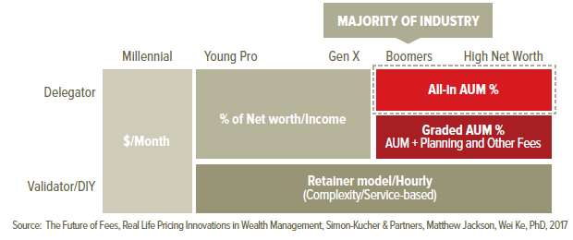
A Look Ahead › The Emerging Fee Landscape
Today’s pricing landscape has not only expanded, it’s decidedly more
client-centric.

Slide 23
The Glue of Advice Management

Slide 24
The Glue of Advice Management › Inside Drives the Outside
Mechanize the inside - Customize the outside
Standardization, automation, and workflows allow you to:
Consistently follow through with commitments and promises
Provide better and more flexible reporting
Reach out proactively, capitalizing on micro-moments
Monitoring of accounts leads to automatic notifications to advisor and investor
Newer types of interaction: video conferencing, scheduling software
Client preferences drive how you interact
Advice Management
Automating the financial planning process

Slide 25
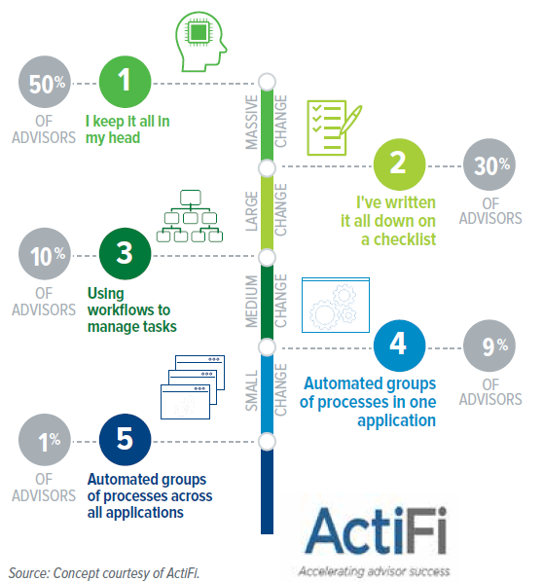
The Glue of Advice Management ›
Five Levels of Technology Utilization

Slide 26

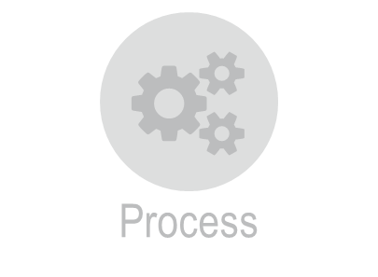
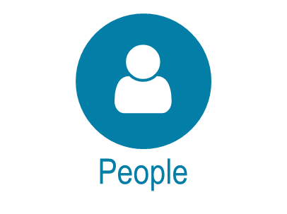
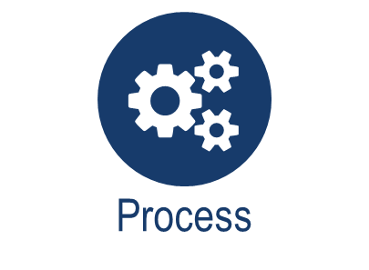




The Glue of Advice Management ›
People, Process and Technology
1/3 on Technology
1/3 on People
1/3 on Process
98% Data Interfaces
1% on People
1% on Process
Staff training
Client training
Defined processes
Automated workflows
Best fit for your advice model
Integrated

Slide 27
The Glue of Advice Management › Where to Start
Biggest challenge for younger firms:
  Lack of time for process
  Grow faster
  Ease bringing on new hires
Mature firms want to improve the way their teams work together.
35% rely on their own memories or checklists to execute business processes, less than 20% rely on automated processes to trigger such tasks.
Pitfalls to watch for:
  There will be members of your team resistant to change
  Change management takes time and commitment
  Don’t try to tackle too much too fast – start with your key three or four processes.
Source: SEI Financial Planning Online Survey, November 2017, n=542 Financial Advisors

Slide 28
The Glue of Advice Management ›
Life Before and After Process Automation
SEI conducted before and after assessments among 46 firms that implemented repeatable processes through the SEI BusinessWise Coaching Program between September 2015 and December 2017. Then, we:
Measured the firm’s views of their efficiency.
Measured the firm’s view of their client satisfaction.
Source: n = 46 firms, between September 2015 and December 2017, before and after they implemented repeatable processes to determine how it ultimately impacted their business; Conducted by ActFi as part of SEI’s workflow program

Slide 29
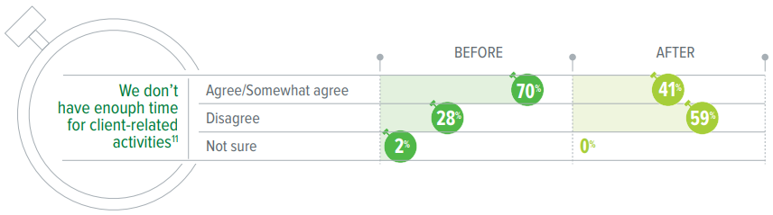
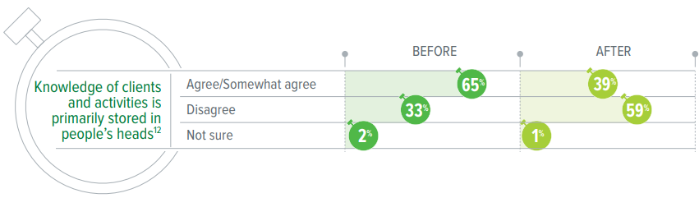
The Glue of Advice Management ›
Life Before and After Process Automation
Source: n = 46 firms, between September 2015 and December 2017, before and after they implemented repeatable processes to determine how it ultimately impacted their business; Conducted by ActFi as part of SEI’s workflow program

Slide 30
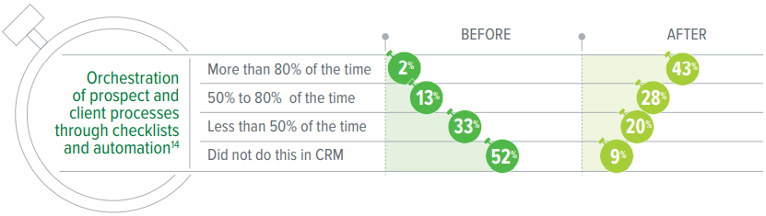
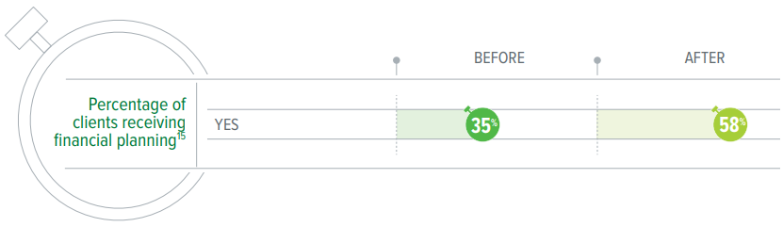
The Glue of Advice Management ›
Life Before and After Process Automation
Since the inception of the Program, there has been a 66% increase in the number of firms offering planning to their clients
Source: n = 46 firms, between September 2015 and December 2017, before and after they implemented repeatable processes to determine how it ultimately impacted their business; Conducted by ActFi as part of SEI’s workflow program

Slide 31
Your Roadmap to an Advice Management Business Model

Slide 32
Transitioning Into An Advice Management Process
What technology?
What are the implications?
Roadmap to meet client’s needs – how do you want to serve your clients?
Decide how you want to interact with clients | Decide your planning and process approach | Decide what platform you’ll use
Will segments be treated equally? | Start with your client review meeting | The “Level 5” Approach First, understand the client segment(s) you’re looking to attract.
How you will charge for the service? | What processes do you have in place today? | Then, formulate the workflow for your planning process
Which modules will you start with (e.g., college planning, debt planning, estate planning, and retirement)? | What additional staff or technology will you need to implement? | Finally, implement your technology: Start with your custodian Choose a CRM Select financial planning software Consider: Ease of use Cost Training Documentation

Slide 33
Summary › The Future of Advice Management
Today, there are many ways of providing financial planning to different types of clients.
“Old school” financial planning process is unchanged, but is implemented differently.
New generation of financial planning companies is causing disruption.
Financial planning – key to showing value.
Clients have different planning needs and therefore may need different software (Dennis & Nicole).
The new frontier: Advice Management – automating the financial planning process.
Mechanize the inside – Customize the outside
Notes:
So, to summarize, switching to fee-based helps you:
[Point to and explain each bullet on slide.]
So the next question is: How do I get there? Can I really do this? Where do I start and how do I begin?

Slide 34

Independent Advisor Solutions by SEI › Who We Are
SEI is a leading global provider of wealth management solutions. We help professional wealth managers, institutional investors, and private investors create and manage wealth – and enable their long-term success – by providing solutions that are both comprehensive and innovative.
A Market Leader
Manages $337 billion assets¹
Administers $518 billion in client assets¹
Leading global provider of Bank Trust technology
Relationships with trust departments of 11 of the 20 largest U.S. banks¹
SEI Advisor Network
25 years of experience in providing outsourced solutions to independent advisors
Over 7,500 advisors using SEI’s solution¹
$66 billion in advisors’ AUM¹
SEI is the one of the top U.S. Advisory Third-Party Managed Account Providers³
One-stop accountability with SEI Private
Trust Company
A Successful Company
Founded in 1968, a public company since 1981 (NASDAQ: SEIC)
2017 revenues: $1.52 billion²
2017 net income: $404 million²
A Global Company
3,650 employees worldwide¹
¹As of December 31, 2017
²As of December 31, 2017
³Cerulli Associates, Q3 2017
34

Slide 35
Independent Advisor Solutions › A Comprehensive Solution
INVESTMENT & WEALTH PROGRAMS
ADMINISTRATION & TECHNOLOGY
PRACTICE MANAGEMENT PROGRAMS
Investment Philosophy
Investment Strategies
Wealth Programs
Wealth Platform & Technology
Business Transition
Case Management
Marketing & Growth Programs
Scientific, disciplined, and time-tested approach
Supports liquidity, accumulation & distribution
Targeted asset allocation
Multiple specialist managers with dynamic asset allocation
Ongoing oversight
  Mutual Fund Models
  Managed Accounts
  ETF Strategies
Goals -Based Strategies
Distribution -Focused Strategies
Tax Management
Taxable Ladders
    Corporate
    TIPS
  Municipal Ladders
    National
    State Focused/ Specific
  Banking
  FDIC-insured CD program
  Debit card
  Online bill pay
  Checking
  Securities-backed lines of credit
  Insurance premium payment program (IP3)
  Trusts
  Agent or directed trustee in 50 states
  Charitable giving
  Donor- advised fund
Full Custody
No trading fees
No IRA fees
Automated Trade processing
Auto fee calc & deduction
Systematic withdrawals
Portfolio rebalancing
Model management
Householding
UMA
Proposal System
Tax loss harvesting
Tax reporting
Integrated workflows & approvals
Advisor & Admin custom Dashboards
Online Account app with e-signature
Advanced performance reporting
Goals-based client statements
Account Aggregation
New End-investor website
Comprehensive Downloading capabilities
Deep integration with CRM’s and Fin Planning
Dedicated project management team
Client segmentation
Develop a project plan
Complete IPS & proposals
Complete all account open paperwork
Assist in client meetings
Investment advice, planning, & presentation support
Experienced team of CFAS, CFPS, & CPAS.
Customized performance analytics
Ongoing proposal support
Online proposal tool
Custom marketing materials
Investor- approved seminars
Research papers and commentaries
Quarterly investment reviews
Coaching & growth programs
Market positioning & branding
Marketing planning guides
* Banking services provided by The Bancorp

Slide 36
Disclaimer
Information provided by SEI Advisor Network, a strategic business unit of SEI. Services provided by SEI Investments Management Corporation (SIMC), a wholly owned subsidiary of SEI.
The types of investors have been categorized by SEI based on shared demographics we found meaningful to distinguish between from our study responses and are for illustration only.
SEI, Spenser Segal, Bob Curtis and Hussain Zaidi are not affiliated. Opinions expressed by them are their own. SEI cannot guarantee the accuracy or completeness of the information presented by independent third parties and assumes no responsibility or liability for any incompleteness or inaccuracy.

