Slide 1
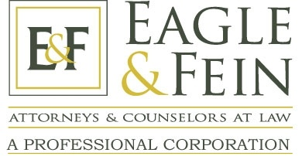
Top 5 Estate Planning Consideration for 2020
Financial Planning Association of
Greater Indiana
Presented by:
Brian A. Eagle, J.D.
Eagle & Fein, P.C.
www.EagleandFein.com

Slide 2
Overview
Spousal Lifetime Access Trust
Family Trust Basis Opportunity Exempt Trust Basis Opportunity
SECURE Act – Roth IRA Conversions
SECURE Act – IRA Relocation to Life Insurance
SECURE Act – Testamentary Charitable Planning
8500 Keystone Crossing, Suite 555, Indianapolis, IN 46240
Phone: (317) 726-1714 Fax: (317) 475-1270
www.eagleandfein.com Facebook.com/EagleandFein

Slide 3
Spousal Lifetime Access Trust (SLAT)
A SLAT is a type of trust in which a spouse creates a trust for the benefit of the other spouse with the remainder interest passing to “heirs.”
The purpose is to provide cash flow to the spouse-beneficiary while keeping the assets secure from creditors.

Slide 4
SLAT
Transfer Assets
SLAT
Donor Spouse
Indirect Benefit
For the Benefit of
For the Benefit of
Future Generations
Donee Spouse

Slide 5
Family Trust Basis Opportunity Exempt Trust Basis Opportunity
Family Trust a/k/a AB Trust, Creditor Shelter Trust, or Bypass Trust
Exempt trusts from Generation Skipping Tax
Family Trust and Exempt Trusts are excluded from the taxable estate of spouse or beneficiary
Exemption amount $11,580,000
each spouse
portability
Search tax returns files for keywords

Slide 6
Family Trust Basis Opportunity Exempt Trust Basis Opportunity
Family Trust:
No step-up in basis on death
Surviving spouse likely has no estate tax issue
Exemption $11,580,000 decreasing to $6,600,000 by 2026
Bernie Sanders proposal - $3,500,000
Exempt Trust:
No step-up in basis on death
Beneficiary likely has no estate tax issue

Slide 7
Family Trust Basis Opportunity Exempt Trust Basis Opportunity
Planning Opportunity - Causing the Excluded Trust to be included in the Estate of the Spouse/Beneficiary:
Step-up in basis to FMV on date of death of Spouse/Beneficiary

Slide 8
Family Trust Basis Opportunity Exempt Trust Basis Opportunity
How to accomplish:
Court Modify to Terminate Trust
Ind. Code § 30-4-3-24.4
Court Modification to Add Special General Power of Appointment
Power of Appt. – limited to exercise in favor descendants and/or credits
Allowing for appointment to credits cause estate inclusions
Can add Independent Trustee Provision that allows Independent Trust turn off the Power of Appointment if laws can unfavorable

Slide 9
Family Trust Basis Opportunity Exempt Trust Basis Opportunity
How to accomplish: - Asset Swap/Sale to Grantor Trust in Exchange for Promissory Note
Existing Excluded Trust is grantor of new included trust (the “New Trust”)
New Trust is Optimal Basis Increase Trust (“OBIT”) and has a “toggle” Special General Power of Appointment to Include Assets
New Trust is a Grantor Trust for Income and Estate Tax Inclusions Purposes
Excluded Trust sells low basis stock for cash or promissory note for low basis or no basis assets of Excluded Trust (Sale is disregarded since it’s a sale between the Grantor (the Excluded Trust) and the OBIT that is drafted to be a Section 678 Grantor Trust
OBIT now owns low or no basis assets
Excluded Trust pays income tax on OBIT’s trust Assets (payment of cash or installment payments are used to pay income taxes of Excluded Trust attributed to OBIT)

Slide 10
Swap/OBIT
Transfer Low or No-Basis Assets
Excluded Trust
OBIT
Installment Note or Cash – Excluded Trust Tax on Income
Step-Up on Beneficiary’s Death
Same Beneficiaries of Excluded Trust

Slide 11
SECURE Act – 3 Beneficiary Categories
Non-Designated Beneficiary
5-Year Rule for benefits of participants who died before their RBD
Participants remaining life expectancy is participant died on or after their RBD (“the Ghost Rule”)
Designated Beneficiary
10-Year Rule: All amounts must be distributed by 12/31 of the year that contains the 10th anniversary of the date of death
Eligible Designated Beneficiary

Slide 12
SECURE Act – Eligible Designated Beneficiary
Requires most non-spouse beneficiaries to withdraw inherited account balances within 10 year of the account owner’s death.
Exceptions for beneficiaries who are either – “Eligible Designated Beneficiaries”
Surviving Spouse
Minor Children of Participant
Beneficiary not less than 10 years younger than participant
Chronically Ill
Disabled

Slide 13
SECURE Act – Eligible Designated Beneficiary
On the subsequent death of the Eligible Designated Beneficiary:
Ten Year Rule applies

Slide 14
See-Through Trusts – Still Apply Under the SECURE Act
Requirements:
The Trust must be valid under state law.
The Trust must be irrevocable or become irrevocable upon the death of the original owner.
The Trust’s underlying beneficiaries must (all) be identifiable individuals.
There can be neither charities nor non-living humans such as pets.
The Trust or detailed beneficiary list must be furnished to the IRA custodian or Plan Administrator by 10/31 in the year after death.

Slide 15
See-Through Trusts – Still Apply Under the SECURE Act
See-Through Trusts maybe either:
Conduit Trusts –
All retirement plan distributions must be passed out more or less immediately to the individual life beneficiary.
The Conduit Beneficiary is considered to be the sole beneficiary.
Have automatic qualification as a See-Through Trust.
Accumulation Trusts –
All beneficiaries who might ever be entitled to receive such accumulation are “counted” for the minimum distribution rules.
All beneficiaries must be individuals.

Slide 16
Planning for Retirement Benefits with Trusts:
Designated Beneficiary
Non-Designated Beneficiary
5-Year payout if participant died before RBD
NO
YES
LE of participant if died on/after RBD
Eligible
Designated Beneficiary
NO
DB 10-Year payout
YES
Surviving Spouse
Minor Child of Participant
Bene not less than 10 years younger
Chronically Ill
Disabled
Conduit: LE
QTIP/Conduit: LE
Accumulation: 10-Year payout
Conduit: LE until the majority, then 10-Year payout
Accumulation: 10-Year payout
Conduit: LE
Accumulation: 10-Year payout
Conduit: LE
If applicable multi-beneficiary trust and: - Separate trust created under trust instrument upon participant’s death payout rules apply separately to separate trust from chronically ill/disabled EDB, or - If under trust instrument no DB other than chronically ill/disabled EDB has any interest in plan until after EDB dies, LE applies.

Slide 17
401(a)(9) Regulations
Foundational Concepts – Required Minimum Distribution (RMD)
RMDs are calculated based upon the aggregate prior year ending account balance divided by the applicable life expectancy factor.
Prior Year 12/31 Balance
RMD =
Life Expectancy Factor

Slide 18
Trust Named as IRA Beneficiary
Naming a Trust as a “Designated Beneficiary”
An IRA can be payable to a Trust
IRA
Beneficiary
Designation Form
Trust
Spouse
Children

Slide 19
Trust Named as IRA Beneficiary
Advantages of Naming a Trust
Protection form unwise or influenced decisions
Creditor Protection
Divorce Protection
Remarriage and/or Blood Line Protection

Slide 20
The Conduit Trust Crisis

Slide 21
Conduit No More?
Conduit provisions were common in Trusts named as beneficiaries of retirement accounts.
With a conduit provision, a Trustee ensures that the beneficiary receives the smallest possible distribution (RMD) over the course of the beneficiary’s lifetime instead of allowing the beneficiary the option of liquidating the account immediately.

Slide 22
Conduit Provision – Spouse as Designated Beneficiary
A Conduit Trust for the surviving spouse will be entitled to all of the minimum distribution benefits of the surviving spouse under the IRS’ rule that the conduit beneficiary is considered the sole beneficiary of the plan.
Thus:
The Trust does not have to commence taking RMDs until the end of the year in which the deceased participant would have reached age 72. [See §401(a)(9)(B)(iv)(l), as amended by SECURE Act.]
10-Year Rule does not apply during the spouse’s lifetime.
Upon the spouse’s death, the 10-Year Rule kicks in.
Warning: An accumulation trust spouse beneficiary is not eligible for life expectancy payout – 10-Year Rule.

Slide 23
Why is the Conduit Provision a Problem for Non-Spouse Beneficiary?
Under the old law, the RMD was determined using the beneficiary’s life expectancy factor. Therefore, a 25-year old had a life expectancy factor of 58.2 years in which to distribute the account over, making the RMD each year very small. This is referred to as a “stretch” payout. A beneficiary paid taxes on a RMD each year, but the tax payments were stretched out over many years.
Under the new law, that same beneficiary, unless other wise exempt, only has 10 years to withdraw the entire balance, making the RMD each year much larger (and the tax payments due much sooner).

Slide 24
Why is the Conduit Provision a Problem (cont’d)
Regardless of the amount, the conduit provision requires that the RMD taken by the Trustee has to be distributed to or for the benefit of the beneficiary.
Instead of protecting a majority of the account by only distributing small RMDs to the beneficiary, the entire amount of the retirement account will be in the beneficiary’s control within 10 years if a conduit provision is used.

Slide 25
How Do We Solve This Problem?

Slide 26
The Big Decision
Most non-spouse beneficiaries must withdraw the entire balance of the retirement account within 10 years, and
The income tax due is accelerated.
Do we save on taxes or protect the retirement account from the beneficiary's (or a some of each):
unwise/influenced decisions,
creditors/lawsuits,
divorce, and/or
remarriage/blood line protections?

Slide 27
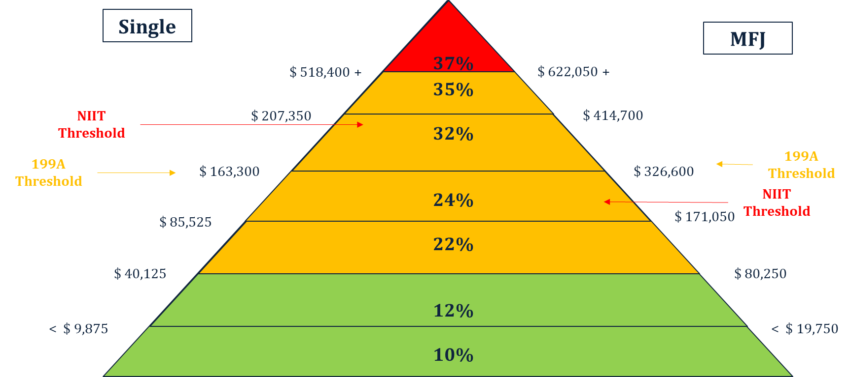
2020 Ordinary Income Tax Rates

Slide 28
Foundational Concepts
2020 Ordinary Income Tax Rates for Estates & Trusts
37%
35%
24%
10%
$ 12,950
$ 9,450
$ 2,600

Slide 29
Review and Amend Documents Now
We need to review client’s documents as soon as possible to determine what is going to happen to their retirement account(s).
If we previously used a conduit provision, we need to consider amending or updating the Trust to prevent the beneficiary from getting the entire balance within 10 years of the participants death.
Consider using an Accumulation Trust.

Slide 30
Solution No. 1 – Roth IRA Conversions
Convert Traditional IRAs into Roth IRAs during participant’s lifetime
Income taxed on conversion
No distribution required at Required Beginning Date
Spread distributions over many years and lower brackets
100% of growth is tax exempt

Slide 31
Solution No. 1 – Roth IRA Conversions
Convertible accounts include:
Traditional IRAs
401(k) plans
Profit sharing plans
403(b) annuity plans
457 plans
“Inherited” 401(k) plans [see Notice 2008-30]
Non-Convertible accounts include:
“Inherited” IRAs and Education IRAs

Slide 32
Solution No. 1 – Roth IRA Conversions
The more time the better – younger clients age 60+
Keep in mind “floors” (e.g. for social security and Medicare Part B&D, Income Related Monthly Adjustment Amount “IRMAA”)
Taxpayer that has a large Charitable Deduction or Charitable Deduction Carryforward (Lifetime CLAT with Roth Conversion)
Taxpayer who can pay the income tax with other funds
Taxpayer who desires to use IRA assets to fund their Basic Exclusion Amount and/or desires remarriage protection or protections for children
Generally lower taxes during lifetime rather than after death

Slide 33
Solution No. 1 – Roth IRA Conversions
Bill has a $2,000,000 IRA (Balance at age 60)
He is currently married to Mary.
Bill is age 60 and Mary is age 62.
They have 3 wonderful children:
Kellie (age 40), Karmen (age 38), and Stephanie (age 36).
Bill desires to include remarriage protection in his planning.
Bill and Mary have $1,500,000 of other assets.
Taxable Income (wants) from age 60-72 is $125,000 per year.
Bill’s death at age 81.
Mary’s death at age 85.
What is the best scenario of maximum tax deferral, what is best for maximum estate planning/remarriage protection?

Slide 34
Solution No. 1 – Roth IRA Conversions Case History
We ran the number on 4 scenarios:
Scenario 1: Spouse as Beneficiary – No Roth Conversion
Scenario 2: See-Through Conduit Family Trust as Beneficiary –
Spouse as designated beneficiary – No Roth Conversion
Scenario 3: See-Through Accumulation Trust as Beneficiary with Roth
Conversion – Taxes paid from other sources
Scenario 4: See-Through Accumulation Trust as Beneficiary with Roth
Conversion – Taxes paid with IRA

Slide 35
Solution No. 1 – Roth IRA Conversions Case History
We ran the number on 4 scenarios (Appendix No. 1)
Scenario 1: Net to Family $ 11,742,719
Net Taxes Paid $ 2,688,576
Scenario 2: Net to Family $ 11,727,829
Net Taxes Paid $ 2,633,896
Scenario 3: Net to Family $ 14,663,468
Net Taxes Paid $ 696,938
Scenario 4: Net to Family $ 14,072,667
Net Taxes Paid $ 688,738

Slide 36
Solution No. 2 – IRA Relocation to Life Insurance
Roth conversions will be the primary way in which large IRAs will avoid exposure to higher rates after death
However, effectiveness of this strategy increase with time
Life Insurance to cover additional tax if the conversion is not completed offsets the risk
Take all or portion of the IRA withdrawal (in the same amount as the Roth Conversion) to fund the life insurance
Scenario 5: Use the IRA distributions to purchase a $1,000,000 life insurance policy [Break Even Analysis]

Slide 37
Solution No. 2 – IRA Relocation to Life Insurance
Scenario 5: Net to Family $ 12,690,213
Net Taxes Paid $ 2,616,417

Slide 38
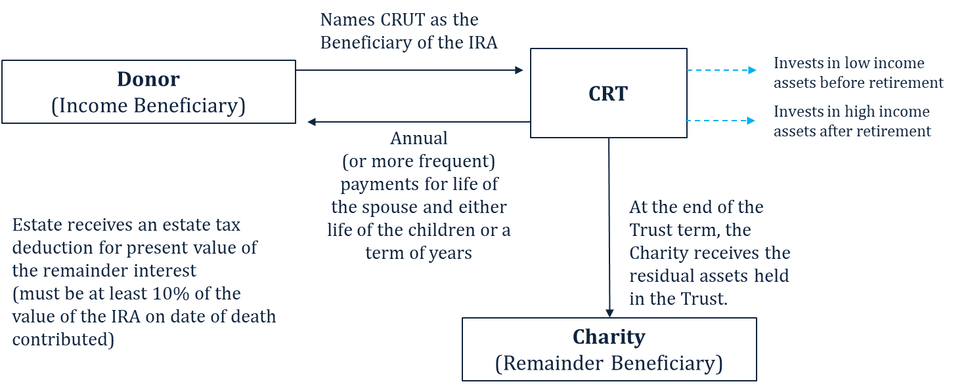
Solution No. 3 – Charitable Remainder Unitrust
Strategy

Slide 39
Solution No. 3 – Charitable Remainder Unitrust
Scenario 6: Net to Family $ 10,051,858
Net Taxes Paid $ 976,139
Net to Charity $ 4,588,827

Slide 40
Summary – How Important is it to Me?
Protection Planning is not important to me:
Primary: Spouse; Contingent: Children
Consider Roth Conversion
Remarriage Protection Planning is important to me:
Primary: See-Through Conduit Family Trust
Contingent: Children
Consider Roth Conversion or Relocation to Life Insurance

Slide 41
Summary – How Important is it to Me?
Protecting my children from unwise/influenced decisions, divorce, creditors, and remarriage (blood line) protections are important to me but not spousal remarriage protection.
Primary: Spouse
Contingent: See-Through Accumulation Trust for each child
Consider Roth IRA Conversion or Relocation to Life Insurance
Consider “Ghost” from owner’s age 72-80 (greater than 10 years)
Giving back to my community is important.
Primary Beneficiary: Two Lives T-CRUT, with spouse as first life followed by either term of years (no more than 20) or depending on the age of the children life to children.
At the end of income term, distributes to Charities – including Donor Advised Funds, Private Foundations, or Named Charities

Slide 42
What should I do next?
Ask your clients the “How Important” questions.
As necessary, coordinate with experience estates planning attorney.
Create a Beneficiary Roth IRA Conversion Analysis.

Slide 43
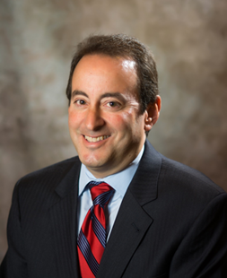
Brian A. Eagle, J. D.
beagle@eagleandfein.com
Brian A. Eagle is a nationally recognized attorney, educator, author, and wealth strategy consultant. He is a member of the WealthCounsel and an Instructor at the InKnowVision Institute. Together with his colleagues he is a co-author of the highly acclaimed books, Legacy, Plan, Protect & Preserve Your Estate, 1996, Esperti Peterson Institute, Generations, 1998, Esperti Peterson Institute, Strictly Business – Planning Strategies for Privately Owned Businesses, 2002, Quantum Press, and Estate Planning Strategies, Collective Wisdom Proven Techniques, 2009, Wealth Builders Press, LLC. He has also published numerous articles as well as lectured on various topics, including ESOPs, business, tax, and estate planning.
Brian is a graduate of Indiana University (B.S. Accounting, 1986) and Hofstra University (J.D. 1990). He is admitted to practice in the states of New York, Connecticut, and Indiana. Brian is the Indianapolis, Indiana founder and managing attorney of the law firm, Eagle & Fein. He is a co-founder of both Legacy Administration Services, a company focusing on estate planning administration and Connect2A.com, a software application service for accountants, attorneys, and financial professionals. Brian passed the Certified Public Accountant Examination in 1988. He is a member of the Indianapolis, Indiana State, and American Bar Associations.
Brian is currently a member of the Central Indiana Community Foundation’s Cornerstone Advisory Council and previously a member of their Professional Leadership Council. In November 2000, Brian received the Professional Partners in Philanthropy Award from the Central Indiana Community Foundation, in recognition of his service to the foundation.
From 2010-2013 Brian was recognized in the Indianapolis Monthly Magazine as a Top Scoring Wealth Manager
for Highest Overall Satisfaction.
In 2001, Brian served as an Adjunct Professor of the Academy of Multidisciplinary Practice at Michigan
State University.
Brian served as student manager of the Indiana University Men’s Soccer Team from 1983-1986.
In 1996, he received the Jerry Yeagley Lifetime Achievement Award and the Indiana Youth
Soccer Association Presidents Award for outstanding contribution to youth soccer in Indiana.
Brian resides in Fishers, Indiana with his wife, Kellie, and his son, Zachary.

Slide 44
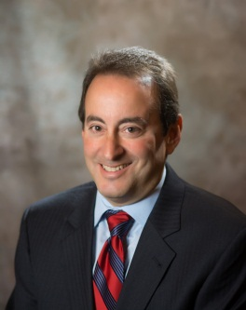
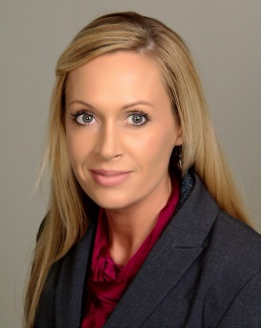
Eagle & Fein, P.C.
Inspiring People to Plan
Areas of Practice:
Estate Planning
Wealth Strategies Design
Business Succession Planning
ESOPs
Corporate Counsel
Business Transactions
Estate / Trust Administration
Elder Law / VA & Medicaid Planning
Probate & Trust Litigation
Brian A. Eagle
Carol J. Greer
Scott J. Linneweber
Managing Attorney
Associate Attorney
Associate Attorney
8500 Keystone Crossing, Suite 555, Indianapolis, IN 46240
Phone: (317) 726-1714 Fax: (317) 475-1270
www.eagleandfein.com Facebook.com/EagleandFein

